Slide 1

Internal Collaboration
External Collaboration
Technical Evidence Base
Theories of Change
Scenario Planning
M&E for Learning
Pause & Reflect
Adaptive Management
Openness
Relationships & Networks
Continuous Learning & Improvement
Knowledge Management
Institutional Memory
Decision Making
Mission Resources
CLA in Implementing Mechanisms

Slide 3

NOTES
Internal Collaboration

Slide 5
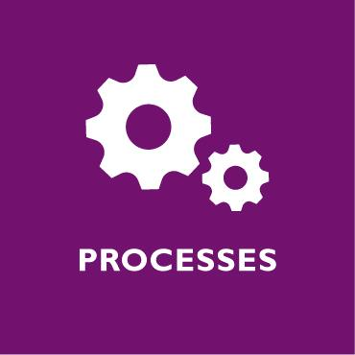
NOTES
Knowledge Management

Slide 7

NOTES
Continuous Learning and Improvement

Slide 9
NOTES
Openness

Slide 11
NOTES
Relationships and Networks

Slide 13
NOTES
Institutional Memory

