Slide 1
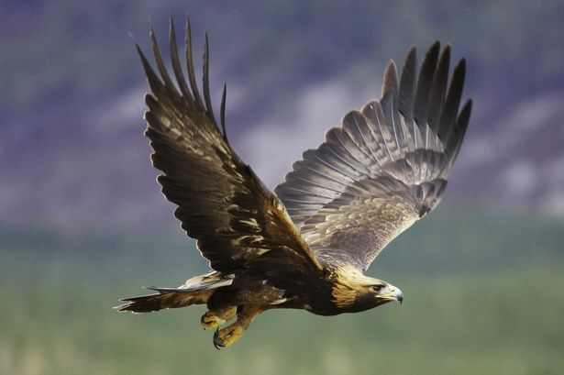
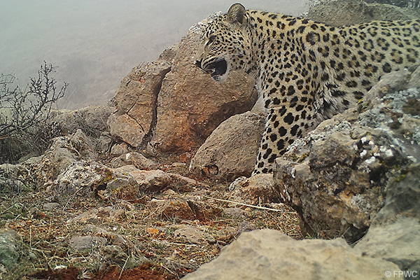
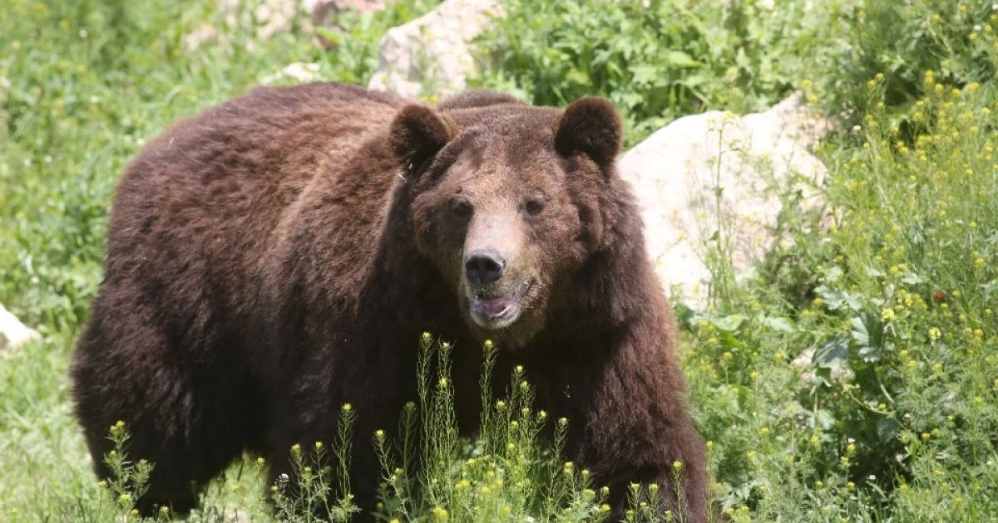
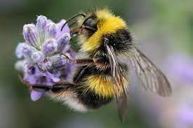
June 2022 Portfolio Review
Example: The Leopards!
The X team mascot is a Y animal because….
Notes:
This has been a crazy year, so we hope we can begin our PR presentations on a fun and light note.
For the first slide:
Choose a team mascot and add a photo of your mascot to the slide
Write one sentence on the slide explaining why your team chose the mascot you did.
Feel free to just use a google image search like I did on this example slide.

Slide 2
Setting the Scene
[insert DO-level performance metrics here - a stoplight chart of the RF is good for easy reference]
[insert DO-level context indicators here]

Slide 3
Unpacking Context
 | How has COVID affected your programming? | How has the conflict in NK affected your programming? | How has the war in Ukraine and/or sanctions against Russia affected your programming? | Other/ Anticipated Contextual Changes
Observation
Findings from Programmatic evidence (reporting, evaluations, etc.)
Conclusion
Notes:
The ADS defines context as, “Conditions and external factors relevant to implementation of USAID’s Strategies, projects, and activities. Context includes the environmental, economic, social, or political factors that affect implementation, as well as how local actors, their relationships, and the incentives that guide them affect development results. It also includes risks that might threaten or provide opportunities to achieve greater development impact.” Use this slide to detail how COVID, the conflict in NK, Ukraine war/Russian sanctions, and/or other external factors are or could impact programming.
A key piece of evidence to inform this slide will be the programmatic evidence (e.g., reporting, evaluations). Think about using the development hypothesis and assumptions laid out in the PMP and crosswalking the causal links and assumptions to the most recent, Armenia-specific evidence (where available) on COVID, the conflict in NK, and Ukraine war/Russian sanctions.
How has COVID affected your programming?
Data Source: programmatic evidence (e.g., reporting, evaluations) + Operational Observations
This question is mandatory.
Observation: In two or three sentences, explain what you have observed in your work over the past 6 months in relation to COVID. How has the issue manifested itself? For example, has it limited access to beneficiaries? Or changed way or frequency of how you collaborate?
Programmatic Evidence Finding: Then, review what the programmatic evidence says about COVID for your DO. Summarize the key findings here.
COVID Conclusion: Explain how the programmatic evidence confirms or disputes your observations in two or three sentences. Draft a conclusion based on the two piece of information --- you observation and the programmatic evidence finding.
How has the conflict in NK affected your programming?
Data Source: programmatic evidence (e.g., reporting, evaluations) + Operational Observations
This question is mandatory.
Observation: In two or three sentences, explain what have you observed in your work over the past 6 months in relation to the conflict in NK. How has this issue manifested itself, if at all? For example, has it put a wrench in your sustainability plans or in handover to the GOAM?
Programmatic Evidence Finding: Then, review what the programmatic evidence says about the conflict in NK for your DO. Summarize the key findings here.
conflict in NK Conclusion: Here explain how the programmatic evidence confirms or disputes your observations in two or three sentences. Draft a conclusion based on the two piece of information --- you observation and the programmatic evidence finding.
How has the Ukraine war/Russian sanctions affected your programming?
Data Source: programmatic evidence (e.g., reporting, evaluations) + Operational Observations
This question is mandatory.
Observation: In two or three sentences, explain what have you observed in your work over the past 6 months in relation to the Ukraine war/Russian sanctions. How has this issue manifested itself, if at all? For example, has it put a wrench in your sustainability plans or in handover to the GOAM?
Programmatic Evidence Finding: Then, review what the programmatic evidence says about the Ukraine war/Russian sanctions for your DO. Summarize the key findings here.
Ukraine war/Russian sanctions Conclusion: Here explain how the programmatic evidence confirms or disputes your observations in two or three sentences. Draft a conclusion based on the two piece of information --- you observation and the programmatic evidence finding.
Are there more pressing contextual issues in your sector than the Ukraine war/Russian sanctions, conflict in NK, or COVID? If so, please explain by adding more rows to the chart and adding two or three sentences explaining the issue and what the team has observed.
Data Source: Operational Observations
This question is optional - it can be used to address specific impacts of the context (e.g., influx of IDPs from NK) or anything else that is not otherwise captured
If there are other additional contextual issues you would like to address, please include them here.

Slide 4
Adaptive Management
Context Conclusion | Action
COVID Context Conclusion (copy/paste from the light blue Conclusion row on the previous slide)
NK Conflict Context Conclusion
Ukraine war/Russian sanction Context Conclusion
Other Context Conclusion (if any)
Notes:
Adaptive management is an intentional approach to making decision and adjustments in response to new information and changes in context. Adaptive management is how we create and sustain “living documents” and ultimately provide programming that is fresh and responsive.
For each of the conclusions listed on the context slide, slide 2, input the challenge into the “Context Conclusion” template.
For each context conclusion listed, add one of the following actions.
No change needed
If you choose this statement, please explain why you think the strategy is still on track to achieve intended results without adaptation?
Delayed timeline, but no change in achieving results
If you chose this statement, please explain the timeline delay. For example, how long do you expect the delay to be? How might this impact future programming?
Adaptation needed.
If you choose this statement, please detail the explicit actions that are needed to keep the strategy on track to achieve the intended results. Example changes might be:
Incorporating new components or changing the focus of upcoming designs
Extending an existing award
Intensified coordination with GOAMM
Tailoring the PMP

Slide 5
Learning Networks
What have we learned from each others’ experience? | What else would we like to learn from each other?
Notes:
We have all shared some common challenges in our context over the last several years, even though our programming is sometimes quite different.
What have we learned from each other?
List a few things you heard during site visits that surprised you, or made you think “aha!”
What else would we like to learn from each other?
What continuing challenges might benefit from other programs’/partners’ experience or perspective?

Slide 6
Youth
Youth Engagement Opportunities - FY23 | Supporting IMs | Gaps
Notes:
The CDCS says, with respect to the 2018 Velvet Revolution: “a strong latent demand for change, a resilient belief in individual agency and voice, and an awakening to the collective power of a social movement of concerned citizens would change the course of Armenian history….The ensuing political transition elevated a new generation of leaders committed to democratic governance, accountability reforms, and an economic revolution to begin the task of creating a vibrant, inclusive, and resilient economy.”
The CDCS also notes that “Youth unemployment is among the highest in the world, near 40 percent, while the private sector continues to be constrained by human capital deficiencies.”
Taken together, these points illustrate that catalytic opportunities, as well as risks, facing Armenia’s youth.
Identify opportunities to engage the youth in Armenia in the coming Fiscal Year FY23. While we do have some activities explicitly dedicated to Youth, consider if/how programming in other technical areas might leverage this population as well.
Each sector will address youth in different ways and a positive catalyst might look very different in EG vs. DG. This may be workforce development for youth, or civic education, and/or increased engagement of youth in the political process, for example.
List at least one, but no more than three catalysts.
List the IM’s in your portfolio which do (or could) support each opportunity listed.
Identity any gaps that may exist which present a challenge to engage youth or achieve positive youth outcomes.

Slide 7
Gender and other marginalized groups (esp. persons with disabilities)
DO1: Democratic Transition Advanced
DO2: Economic Security Enhanced
Contributing IMs:
Contributing Implementing Mechanisms
Contributing Implementing Mechanisms
Contribution
Contribution
Notes:
The CDCS addresses specific gender outcomes under each Development Objective. This slide summarizes those objectives. On this slide each team should:
Delete the non-relevant DO.
List the contributing Implementing Mechanisms to the gender outcomes in the relevant DO.
Summarize 1-3 key outcomes that are furthering this gender outcome in your DO.
Please feel free to add any specific outcomes about other marginalized groups here as well (e.g., youth, women and girls, persons with disabilities, LGBTQIA+-identifying persons, and other traditionally marginalized groups, including persons living outside of Yerevan).
Note: During the presentation, the technical team will not present this slide. It will be used by the cross-cutting working group and feed into the larger gender presentation.

Slide 8
Achieving Results through Partnerships
IR | Partnership | Supporting Mechanisms | Adaptations Needed
IR 1.1 - Effective and accountable governance institutionalized IR 1.2 - Citizen engagement for democratic consolidation increased
IR 2.1 - Economic governance strengthened IR 2.2 - Competitiveness of target sectors increased IR 2.3 - Sustainable management of natural resources improved
Notes:
This slide depicts how partnerships help us achieve our results and invites your portfolio to examine existing partnerships in light of the strategic results laid out in the CDCS.
List the CDCS intermediate results for your portfolio in the IR column.
Partnerships are defined as stakeholders that play a critical role in increasing and better sustaining the development impact of our assistance. Examples are listed below. In the partnership column, list the partnerships that are needed to support and achieve the intermediate result. Ex:
Government of Armenia
Private Sector
Civil society
Peace Corps, DOD
Other bilateral, multilateral donors
Supporting Mechanisms
List each IM in your portfolio and/or external mechanisms which supports the identified partnership ie. other donors, local government, local CSOs, private sector, etc.
List only the top three mechanisms
How might these partnerships need to adapt to contextual changes?
Given the contextual review on slide two, how might each partnership need to adapt, doe it need to adapt so that it can better support or continue to support USAID objectives?
The possible response in this column are:
No adaptations needed
Adaptations needed
For this response, please also explain what concrete actions need to be taken in the partnership to respond to the context.
Examples might be: Intensified involvement in a multi-donor coordination mechanism or developing new communication channels

Slide 9
Top Three Accomplishments
Spotlight
Spotlight
Spotlight
Summary
Summary
Summary
Key Achievement
Key Achievement
Key Achievement
Key Achievement
Key Achievement
Key Achievement
Key Achievement
Key Achievement
Key Achievement
Notes:
This slide presents a chance to shine a spotlight on any of the accomplishments in your portfolio. Each of the three boxes on the slide should represent an accomplishment/spotlight in a mini-case study format.
Where it says “Spotlight” Give your accomplishments a short, one or two word title.
Provide a one sentence or two description of the achievement where the template says “summary”
List key outputs or concrete accomplishments in the bullet point list at the end.

Slide 10
Top Three Challenges That Keep Us Up at Night
Challenge
Challenge
Challenge
Challenge
Summary
Summary
Summary
Action 1
Action 2
Action 3
Action 1
Action 2
Action 3
Action 1
Action 2
Action 3
Notes:
Programming doesn’t always go as expected and sometimes challenges arise. This slide should discuss the top three challenges that are keeping us up at night --- and maybe could be going better. For each challenge keeping you up at night:
Add a one or two word title where it says, “Challenge”
Summarize the challenge in a few sentences where it says “summary”
And add 1-3 actions in the bullet point list that your portfolio is doing (or could do) to address the challenge.

Slide 11
Implications for ABR and/or PPR narratives…
SPO to add selected ABR/PPR key issues to this slide ahead of FBLRs. Teams will then add any learnings from the site visits that speak to these key issues.

Slide 12
Wildcard Slide
Share anything!
Notes:
This is a wildcard slide and can be used to share anything else you would like your colleagues to know. Some suggestions include:
IM Success stories
Team member shout-outs
Key team accomplishments/highlights
What you need from the support and Front offices

Slide 13
Meme us all about it!
Add your meme here!
Notes:
Just in case you don’t know what a meme is… A meme is an amusing or interesting item (such as a captioned picture or video) or genre of items that is spread widely online especially through social media. On this final slide of the portfolio reviews we are asking your team to create one meme that represents your experience with the challenges we’ve faced over the last two years. It should be funny and fun, (and safe for work, of course) something to help us commiserate and celebrate our experience over the last two years.
Steps to creating a meme:
Decide amongst your team a fun idea for your meme
Go to https://www.kapwing.com/studio/editor (or your favorite meme creator, if you have one)
Create your meme
Export your meme
Add your meme to this slide

Slide 14
Tell us about your experience with this Portfolio Review
We liked…
We learned…
We wish…

