Slide 1
Portfolio Reviews
Making them less burdensome and more useful

Slide 2
Why do we do Portfolio Reviews?
ADS 201 requires that missions complete one portfolio review per year that focuses on strategy-level results:
Progress toward achieving CDCS DOs; expectations regarding future progress
Country and regional trends and how the context is evolving
The status of key risks, critical assumptions, and implications for performance of the CDCS and activities
The extent to which IPs collect and use feedback from beneficiaries
What USAID has learned from monitoring data, evaluations, beneficiary feedback, etc.
Opportunities to adapt as a result of learning
The status of cross-cutting themes
The allocation and management of resources
Status of actions in Post-Evaluation Action Plans
Challenges and next steps for improving

Slide 3
Problem Statement
Portfolio Reviews often are…
A huge burden to prepare - cite average estimated LOE from survey
Focused on activity-level (rather than strategic) reporting
A “box checking” exercise that doesn’t usually inform learning or adaptation
Boring!
Why are we spending so much of our time on something that doesn’t help us??

Slide 4
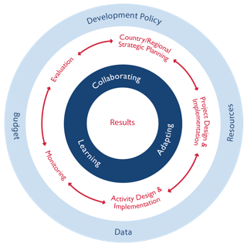
Let’s try something different
Objectives:
Understand how our activities are contributing to CDCS-level results.
Learn from implementation so far and changes in context, in order to adapt our existing activities and design new ones.
Foster trust-based relationships for learning along with our partners and problem-solve together.
Systematically collect data to inform PPR, ABR, programmatic and/or operational adaptations we can make, MCST, next CDCS.

Slide 5
Annual Strategic Portfolio Review Process Map
Activity Quarterly Reports
AMELPs
PMP Learning Questions
DO-level data from DIS
ABR - what budget do we need to make the adaptations to activities?
Field-based learning reviews
Focuses on strategic learning questions at select sites
Provides cross-learning opportunity for IPs and USAID tech teams
Informs program implementation and adaptation.
All outputs for technical teams are produced while on the site visit!
PPR - what can we say about what we’ve achieved?
3. Mission-internal discussion on learning and next steps
Triangulates learning from the field and IP meetings
Action planning based on the learning
Informs ABR & PPR
Programming - what adaptations do we need to make to our activities?
2. All IP meeting hosted by MD
Uses the already existing platform of MD annual all-IP meeting to focus on strategic questions
Captures voices of IPs working on national level
Triangulates findings from the sites
Provides a venue for feedback from all IPs to USAID
MCST (Step 3)- what adaptations do we need to make to our strategy?
Annual Strategic PR
Next CDCS - what will we need to consider for our new strategy?
Notes:
Talking points for animation:
New PR structure uses carefully chosen site visits to complement other existing events (All-IP meeting and the time we would usually reserve for PR presentations) to orient us toward learning and adaptation.
SPO uses existing data sources and brief interviews with AOR/CORs to collate information in preparation for PRs.
All outputs from the field component is produced on the trip in collaboration with other participants, reducing the report-writing burden for AOR/CORs.
Outputs from Mission-internal meeting are oriented toward decisions/adaptations so that we can best leverage other PC actions in order to be more efficient and effective in achieving our results.

Slide 6
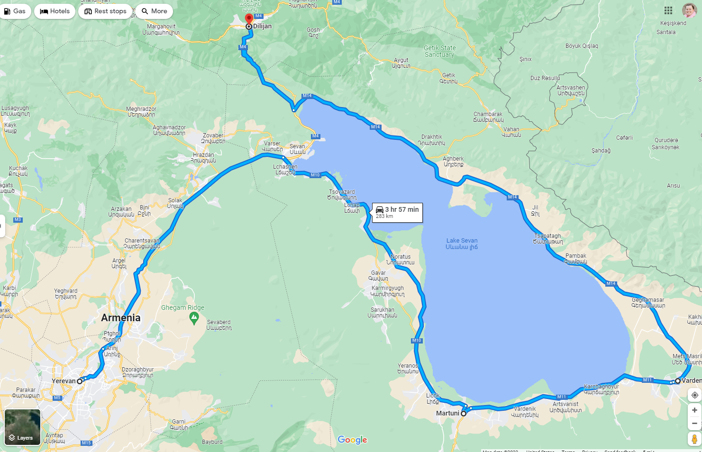
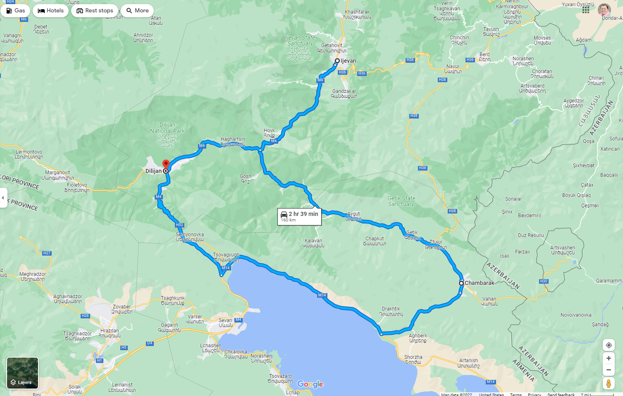
Site Visit Process Map
Site Visit Team A
IPs
Others
Day 1
Learning Guide
Day 2
Learning Guide
2. All-IP Meeting
Field-based learning Reviews
3. Internal Decisional Workshop for Adaptation and Action Planning
Day 1
Learning Guide
Day 2
Learning Guide
4. Share decisions made back to partners
Site Visit Team B
IPs
Others

Slide 7
ABR Narratives that can be informed by this model
2 - Describe how this project coordinates with other relevant projects, regardless of their source of funding.
3 - Summarize progress in the last 12 months. Where you have exceeded your outcomes, or fallen short of them, explain the factors that have affected those results.
5 - How much funding you are requesting for this in FY 2022. Describe the new short and/or long-term results that this new funding would make possible.
6 - Describe which levers of Russian/Kremlin activity the programming counters, or vulnerabilities to such activities, and the CAATSA goal it will support.
Notes:
Derived from FY 2021 ABR Questions - If we want to inform these narratives, we need to be sure to include a question/slide on these topics in the FBLR deck.

Slide 8
PPR narratives that can be informed by this model
Qualitative and observational data obtained via site visits provide important context and nuance to explain:
Deviation narratives - when actual outcome data deviates significantly from that FY’s targets
Ex.: “In FY 2021 the ECRG implemented events and trainings delayed in FY 2020 due to COVID-19 restrictions and the hostilities in NK.”
Key issue narratives - speaking to local implementers and beneficiaries at their sites reveals crucial information about the “how” and “why” behind our quantitative data that are difficult or impossible to capture through other means.
Ex. of Key Issues: Sustainability and Local Ownership; Investing in People Disability Inclusive Development: Participation of Persons with Disabilities; Youth Development and Emerging Leader, COVID-19
Notes:
If we want to inform these narratives, we need to be sure to include a question/slide on these topics in the FBLR deck.

Slide 9
Fall Strategic Portfolio Review informs other PC actions
Ongoing assessments, evaluations, and/or research
Sept 2022
October 2022 - Annual Strategic Portfolio Review
Nov/ Dec 2022
Feb 2023
SPO tests data accessibility in DIS
Select site visits address PMP learning Qs
All-IP Meeting
Internal decisional PR meeting*
PPR & ABR Submission
CDCS Mid-course Stocktaking*
What key performance and context data are readily accessible to us for learning?
How have COVID, NK, sanctions against Russia impacted our programming in selected regions?
Does what we learned in site visits resonate?
What other feedback do IPs have?
What adaptations do we need to make to our programming?
To our operations?
What other assessments do we need for our MCST?
What can we say about what we’ve achieved?
What budget do we need to make the adaptations to activities?
What adaptations do we need to make to our current strategy?
What do we need to learn/consider to prepare for our next strategy?
Notes:
*MCST - NB: In an MCST year, the Internal decisional PR meeting can be PART OF the MCST, rather than a separate meeting
Define expected LOE to prepare

Slide 10
Benefits of this model
Systematizes our PR process - more efficient, deeper analysis
Connects PRs to other required Program Cycle actions, adding value while reducing burden on each of them
Ensures that we invest our time in learning in order to inform any necessary adaptations and exceed our development objectives
Builds a learning community with our partners

