Slide 1
Decisional Meeting for Adaptations from Annual Strategic Portfolio Reviews
Notes:
Copy relevant slides from FBPRs, organize by DO

Slide 2
Problem Statement
Portfolio Reviews often are…
A huge burden to prepare - cite average estimated LOE from survey
Focused on activity-level (rather than strategic) reporting
A “box checking” exercise that doesn’t usually inform learning or adaptation
Boring!
Why are we spending so much of our time on something that doesn’t help us??

Slide 3
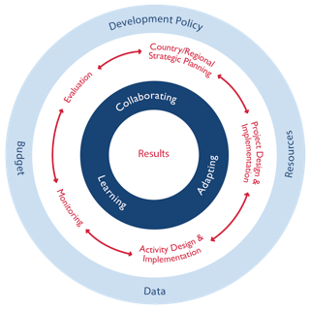
Let’s try something different
Objectives:
Understand how our activities are contributing to CDCS-level results.
Learn from implementation so far and changes in context, in order to adapt our existing activities and design new ones.
Foster trust-based relationships for learning along with our partners and problem-solve together.
Systematically collect data to inform PPR, ABR, programmatic and/or operational adaptations we can makes, MCST, next CDCS.

Slide 4
Annual Strategic Portfolio Review Process Map
Activity Quarterly Reports
AMELPs
PMP Learning Questions
DO-level data from DIS
ABR - what budget do we need to make the adaptations to activities?
Field-based learning reviews
Focuses on strategic learning questions at select sites
Provides cross-learning opportunity for IPs and USAID tech teams
Informs program implementation and adaptation.
All outputs for technical teams are produced while on the site visit!
PPR - what can we say about what we’ve achieved?
3. Mission-internal discussion on learning and next steps
Triangulates learning from the field and IP meetings
Action planning based on the learning
Informs ABR & PPR
Programming - what adaptations do we need to make to our activities?
2. All IP meeting hosted by MD
Uses the already existing platform of MD annual all-IP meeting to focus on strategic questions
Captures voices of IPs working on national level
Triangulates findings from the sites
Provides a venue for feedback from all IPs to USAID
MCST (Step 3)- what adaptations do we need to make to our strategy?
Annual Strategic PR
Next CDCS - what will we need to consider for our new strategy?
Notes:
Talking points for animation:
New PR structure uses carefully chosen site visits to complement other existing events (All-IP meeting and the time we would usually reserve for PR presentations) to orient us toward learning and adaptation.
SPO uses existing data sources and brief interviews with AOR/CORs to collate information in preparation for PRs.
All outputs from the field component is produced on the trip in collaboration with other participants, reducing the report-writing burden for AOR/CORs.
Outputs from Mission-internal meeting are oriented toward decisions/adaptations so that we can best leverage other PC actions in order to be more efficient and effective in achieving our results.

Slide 5
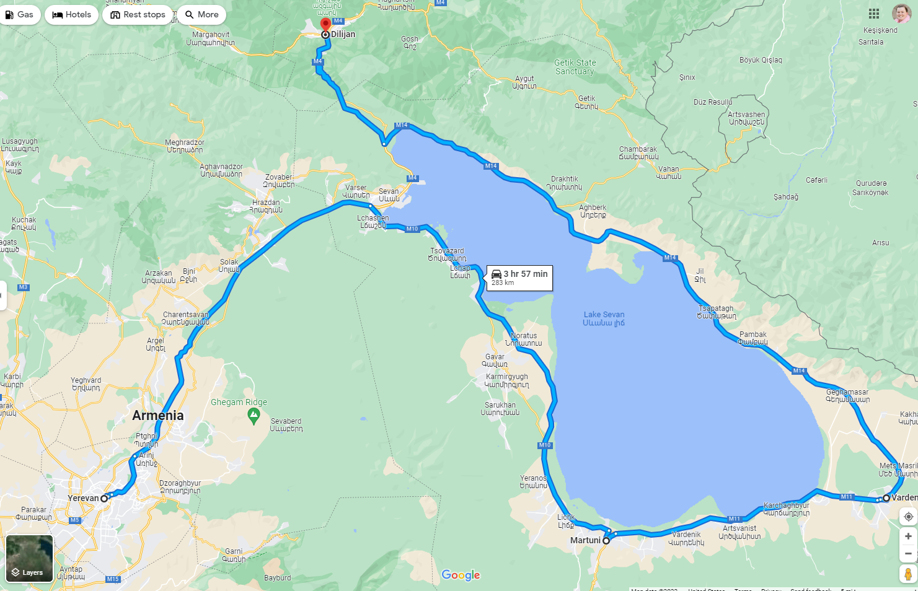
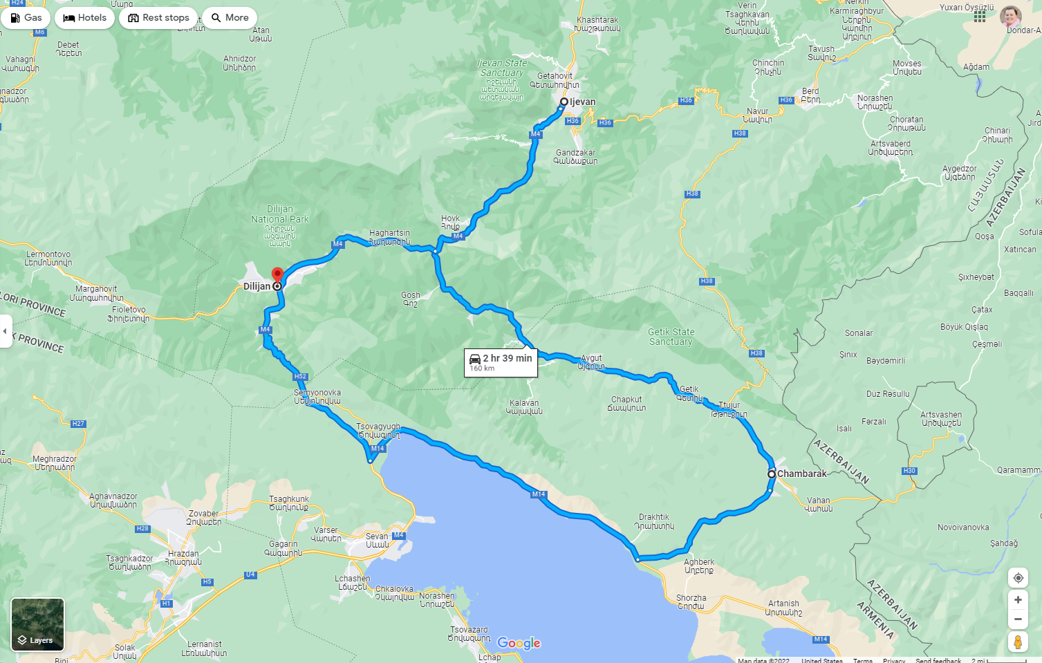
Site Visit Process Map
Site Visit Team A
IPs
Others
Day 1
Learning Guide
Day 2
Learning Guide
2. All-IP Meeting
Field-based learning Reviews
3. Internal Decisional Workshop for Adaptation and Action Planning
Day 1
Learning Guide
Day 2
Learning Guide
4. Share decisions made back to partners
Site Visit Team B
IPs
Others

Slide 6
Setting the Scene
[insert DO-level performance metrics here - a stoplight chart of the RF is good for easy reference]
[insert DO-level context indicators here]

Slide 7
Top Three Accomplishments
Spotlight
Spotlight
Spotlight
Summary
Summary
Summary
Key Achievement
Key Achievement
Key Achievement
Key Achievement
Key Achievement
Key Achievement
Key Achievement
Key Achievement
Key Achievement
Notes:
This slide presents a chance to shine a spotlight on any of the accomplishments in your portfolio. Each of the three boxes on the slide should represent an accomplishment/spotlight in a mini-case study format.
Where it says “Spotlight” Give your accomplishments a short, one or two word title.
Provide a one sentence or two description of the achievement where the template says “summary”
List key outputs or concrete accomplishments in the bullet point list at the end.

Slide 8
Top Three Challenges That Keep Us Up at Night
Challenge
Challenge
Challenge
Challenge
Summary
Summary
Summary
Action 1
Action 2
Action 3
Action 1
Action 2
Action 3
Action 1
Action 2
Action 3
Notes:
Programming doesn’t always go as expected and sometimes challenges arise. This slide should discuss the top three challenges that are keeping us up at night --- and maybe could be going better. For each challenge keeping you up at night:
Add a one or two word title where it says, “Challenge”
Summarize the challenge in a few sentences where it says “summary”
And add 1-3 actions in the bullet point list that your portfolio is doing (or could do) to address the challenge.

Slide 9
What else did we hear from our partners at the All-IP meeting?

Slide 10
Learning Networks
What have we learned from each others’ experience? | What else would we like to learn from each other?
Notes:
We have all shared some common challenges in our context over the last several years, even though our programming is sometimes quite different.
What have we learned from each other?
List a few things you heard during site visits that surprised you, or made you think “aha!”
What else would we like to learn from each other?
What continuing challenges might benefit from other programs’/partners’ experience or perspective?

Slide 11
Adaptive Management
Context Conclusion | Action
COVID Context Conclusion (copy/paste from the light blue Conclusion row on the previous slide)
NK Conflict Context Conclusion
Ukraine war/Russian sanction Context Conclusion
Other Context Conclusion (if any)
Notes:
Adaptive management is an intentional approach to making decision and adjustments in response to new information and changes in context. Adaptive management is how we create and sustain “living documents” and ultimately provide programming that is fresh and responsive.
For each of the conclusions listed on the context slide, slide 2, input the challenge into the “Context Conclusion” template.
For each context conclusion listed, add one of the following actions.
No change needed
If you choose this statement, please explain why you think the strategy is still on track to achieve intended results without adaptation?
Delayed timeline, but no change in achieving results
If you chose this statement, please explain the timeline delay. For example, how long do you expect the delay to be? How might this impact future programming?
Adaptation needed.
If you choose this statement, please detail the explicit actions that are needed to keep the strategy on track to achieve the intended results. Example changes might be:
Incorporating new components or changing the focus of upcoming designs
Extending an existing award
Intensified coordination with GOAMM
Tailoring the PMP

Slide 12
Now, let’s make some plans to implement these adaptations!

Slide 13
Youth
Youth Engagement Opportunities - FY23 | Supporting IMs | Gaps
Notes:
The CDCS says, with respect to the 2018 Velvet Revolution: “a strong latent demand for change, a resilient belief in individual agency and voice, and an awakening to the collective power of a social movement of concerned citizens would change the course of Armenian history….The ensuing political transition elevated a new generation of leaders committed to democratic governance, accountability reforms, and an economic revolution to begin the task of creating a vibrant, inclusive, and resilient economy.”
The CDCS also notes that “Youth unemployment is among the highest in the world, near 40 percent, while the private sector continues to be constrained by human capital deficiencies.”
Taken together, these points illustrate that catalytic opportunities, as well as risks, facing Armenia’s youth.
Identify opportunities to engage the youth in Armenia in the coming Fiscal Year FY23. While we do have some activities explicitly dedicated to Youth, consider if/how programming in other technical areas might leverage this population as well.
Each sector will address youth in different ways and a positive catalyst might look very different in EG vs. DG. This may be workforce development for youth, or civic education, and/or increased engagement of youth in the political process, for example.
List at least one, but no more than three catalysts.
List the IM’s in your portfolio which do (or could) support each opportunity listed.
Identity any gaps that may exist which present a challenge to engage youth or achieve positive youth outcomes.

Slide 14
Gender and other marginalized groups (esp. persons with disabilities)
DO1: Democratic Transition Advanced
DO2: Economic Security Enhanced
Contributing IMs:
Contributing Implementing Mechanisms
Contributing Implementing Mechanisms
Contribution
Contribution
Notes:
The CDCS addresses specific gender outcomes under each Development Objective. This slide summarizes those objectives. On this slide each team should:
Delete the non-relevant DO.
List the contributing Implementing Mechanisms to the gender outcomes in the relevant DO.
Summarize 1-3 key outcomes that are furthering this gender outcome in your DO.
Please feel free to add any specific outcomes about other marginalized groups here as well (e.g., youth, women and girls, persons with disabilities, LGBTQIA+-identifying persons, and other traditionally marginalized groups, including persons living outside of Yerevan).
Note: During the presentation, the technical team will not present this slide. It will be used by the cross-cutting working group and feed into the larger gender presentation.

Slide 15
Achieving Results through Partnerships
IR | Partnership | Supporting Mechanisms | Adaptations Needed
IR 1.1 - Effective and accountable governance institutionalized IR 1.2 - Citizen engagement for democratic consolidation increased
IR 2.1 - Economic governance strengthened IR 2.2 - Competitiveness of target sectors increased IR 2.3 - Sustainable management of natural resources improved
Notes:
This slide depicts how partnerships help us achieve our results and invites your portfolio to examine existing partnerships in light of the strategic results laid out in the CDCS.
List the CDCS intermediate results for your portfolio in the IR column.
Partnerships are defined as stakeholders that play a critical role in increasing and better sustaining the development impact of our assistance. Examples are listed below. In the partnership column, list the partnerships that are needed to support and achieve the intermediate result. Ex:
Government of Armenia
Private Sector
Civil society
Peace Corps, DOD
Other bilateral, multilateral donors
Supporting Mechanisms
List each IM in your portfolio and/or external mechanisms which supports the identified partnership ie. other donors, local government, local CSOs, private sector, etc.
List only the top three mechanisms
How might these partnerships need to adapt to contextual changes?
Given the contextual review on slide two, how might each partnership need to adapt, doe it need to adapt so that it can better support or continue to support USAID objectives?
The possible response in this column are:
No adaptations needed
Adaptations needed
For this response, please also explain what concrete actions need to be taken in the partnership to respond to the context.
Examples might be: Intensified involvement in a multi-donor coordination mechanism or developing new communication channels

Slide 16
Wildcard Slide
Share anything!
Notes:
This is a wildcard slide and can be used to share anything else you would like your colleagues to know. Some suggestions include:
IM Success stories
Team member shout-outs
Key team accomplishments/highlights
What you need from the support and Front offices

Slide 17
Tell us about your experience with this Portfolio Review
We liked…
We learned…
We wish…

