Slide 1
THEORY OF CHANGE DEVELOPMENT: A STEP-BY-STEP PROCESS FOR DEVELOPING OR STRENGTHENING THEORIES OF CHANGE

Slide 2
INTRODUCTION TO THIS SLIDE DECK
About this resource:
The Theory of Change Workbook was originally created for the USAID/Vietnam theory of change clinics for implementing partners, and has been refined through several rounds of use and feedback from USAID/Vietnam and partners. It can be used by design and start-up teams to develop or strengthen their theories of change with local stakeholders. This slide deck has been created to mirror the workbook and provide a template for teams to use during in-person or online sessions.
Links to theory of change resources:
Theory of Change Workbook: A Step-by-Step Process for Developing or Strengthening Theories of Change
Theory of Change samples

Slide 3
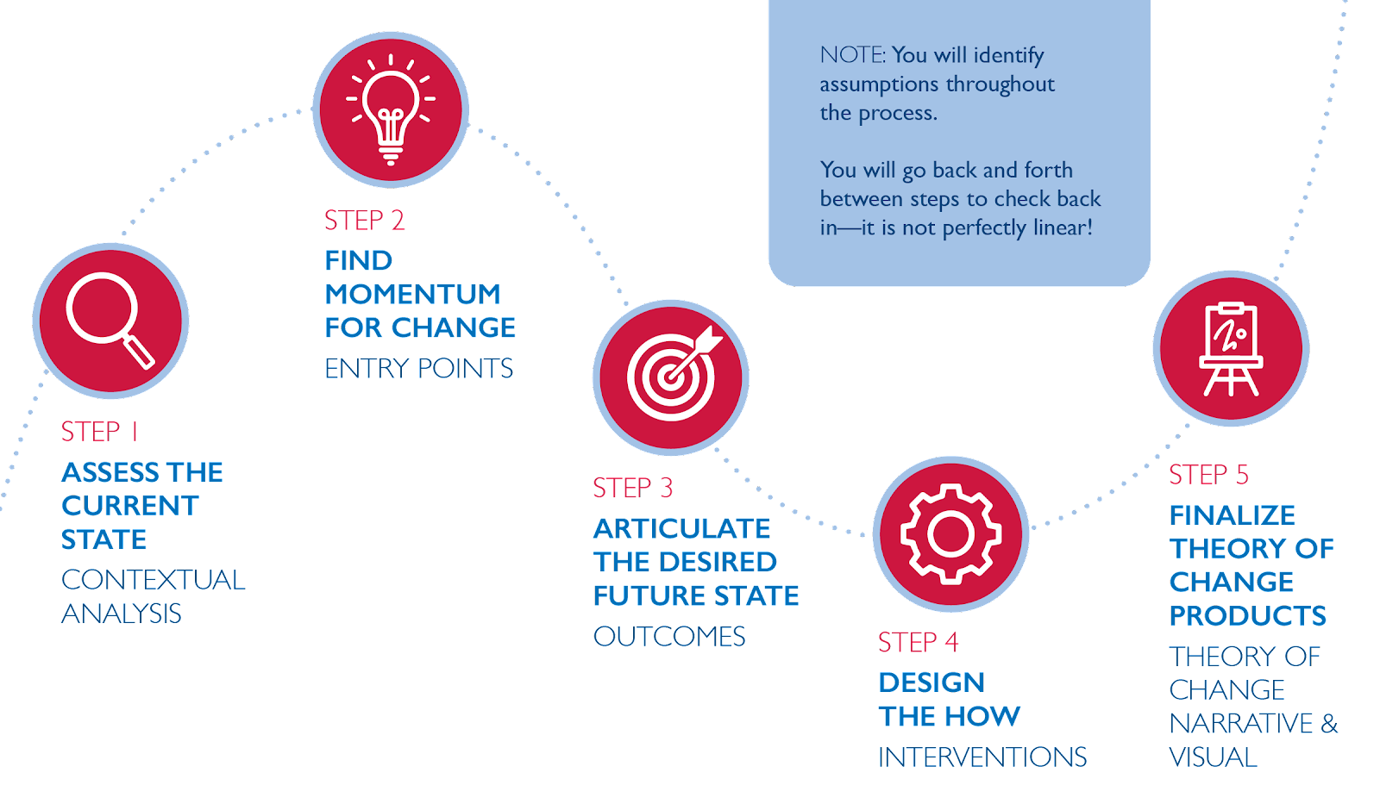
5-Step Theory of Change Development Process

Slide 4



A STRONG THEORY OF CHANGE HAS 4 ELEMENTS
ENTRY POINTS
INTERVENTIONS
Based on our understanding of the local context: where is there is momentum for change?
How will we achieve the intended change?
OUTCOMES
ASSUMPTIONS
What is the change we are trying to achieve? (North Star)
Why do we think this approach will work?

Slide 5
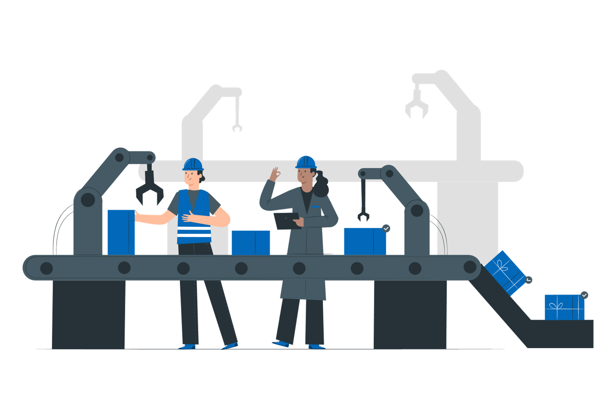


A strong theory of change process leads to stronger theory of change products, which include:
The theory of change narrative: a 1-3 page description of the context and responses to the questions above and
.
A logic model: a visual representation of the theory of change narrative
.

Slide 6
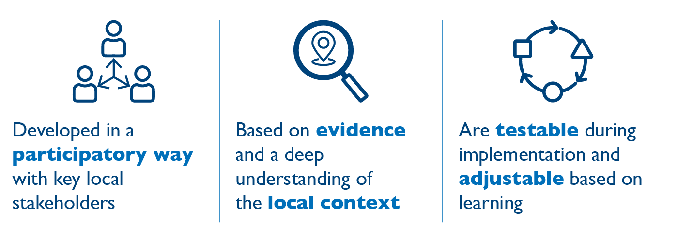
Strong theories of change are:

Slide 7
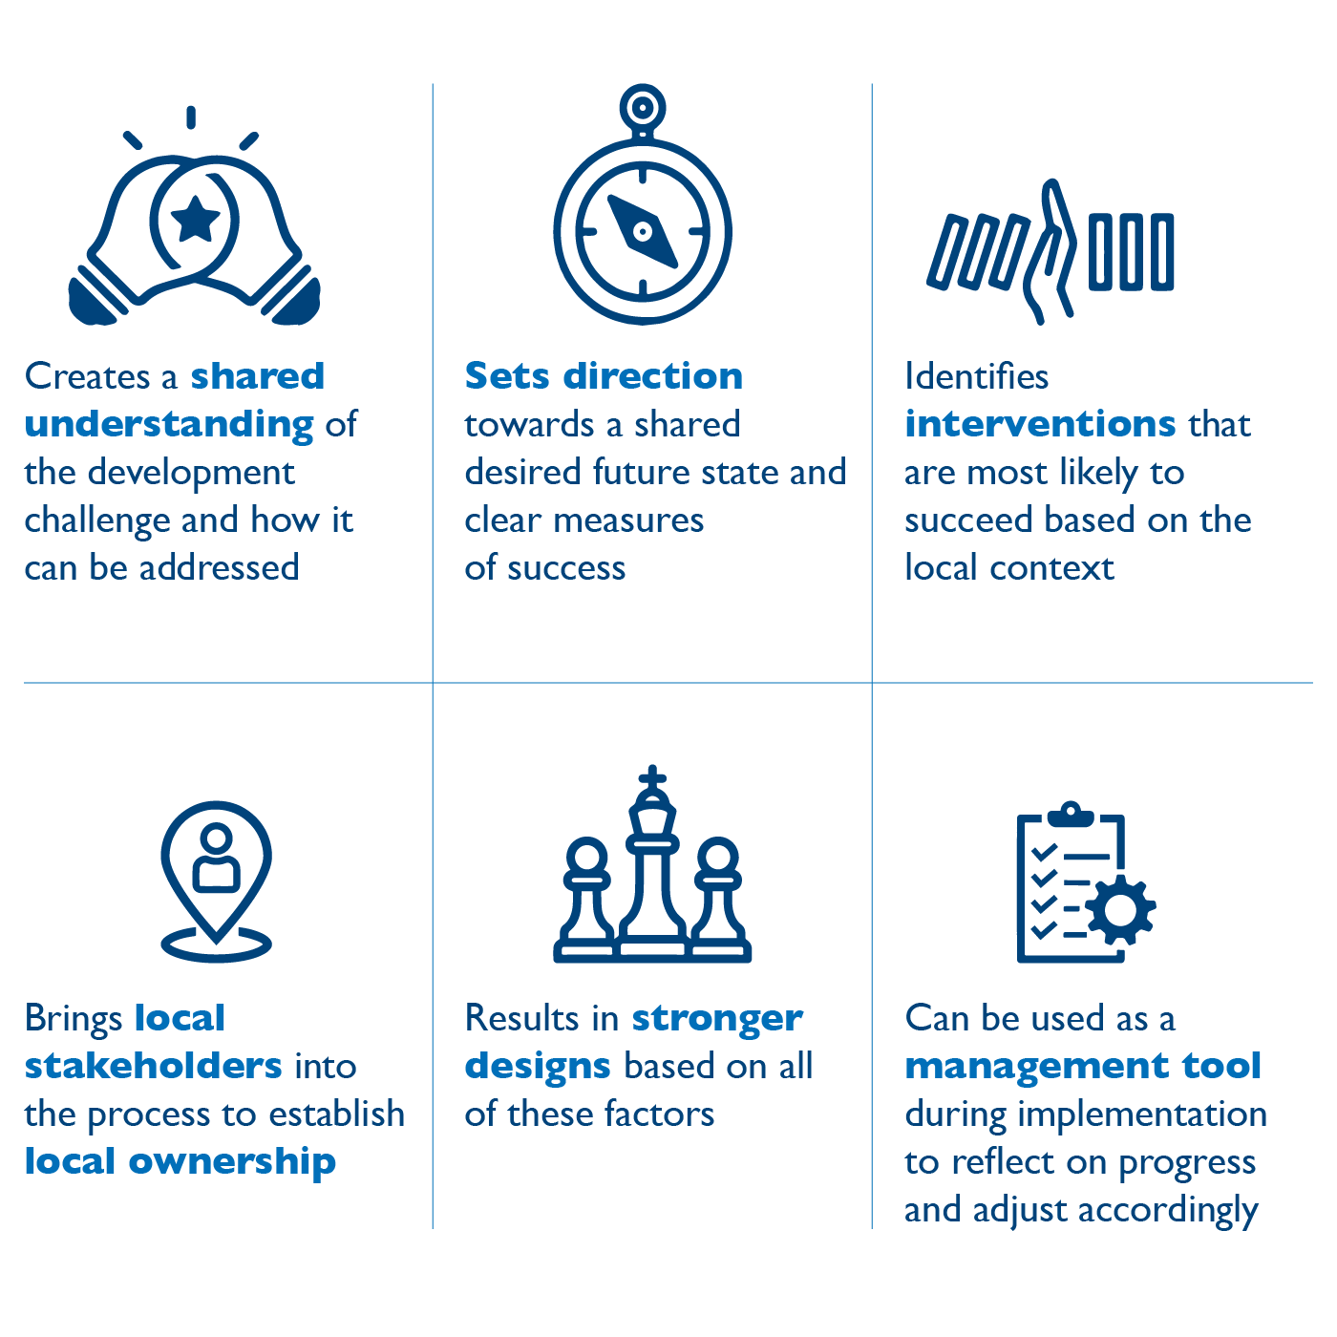
Teams should invest in a more robust and collaborative theory of change development process because it:

Slide 8

STEP 1:
ASSESS THE CURRENT STATE: CONTEXTUAL ANALYSIS
WHY? Without this step, your theory of change will not be specific to the context and you will be unable to identify entry points in Step 2.
PRO-TIP: If you get to this stage without having done a contextual analysis (or having worked on the challenge for some time), you may find that you do not know enough about the current state. If that is the case, it is a great time to articulate learning questions (you can borrow from the questions below) that can inform some kind of assessment to better understand the challenge.

Slide 9
STEP 1: ASSESS THE CURRENT STATE: CONTEXTUAL ANALYSIS 1
PART A: YOUR DEVELOPMENT CHALLENGE
What is the development challenge your activity intends to address?
Use the table below to articulate it. Be as specific as possible.
What is the development challenge?
Your responses:
Why does it matter? To whom does it matter?
Your responses:

Slide 10
STEP 1: ASSESS THE CURRENT STATE: CONTEXTUAL ANALYSIS 2
PART B: THE CONTEXT OF YOUR DEVELOPMENT CHALLENGE
Directions: Consider the contextual situation of your development challenge using the guiding questions.
 | Questions to consider (Note: you do not need to answer each question; they are here as a guidepost to generate ideas & discussion.)
Foundational factors | What are the factors that are fixed or slow to change (such as geography, natural resource endowments or class structures) that affect the development challenge? What are the specific gaps that exist between men, women, or other gendered identities related to the development challenge?
Your responses:
Current outcomes | What outcome is the local system currently producing? Are there trends (increasing, decreasing) in the outcome over time? Do beneficiaries experience differential outcomes? Are these differences based on gender, age, ethnicity, disability status, or other differences pertinent to the local context? How are the current outcomes produced by the local system viewed by local actors ? What other outcomes (positive/negative) do actors note about the local system? Does the challenge have a high profile in national or local politics, and why? How does the government view it? How adaptive, resilient, or self-sustainable does the local system seem to be?
Your responses:

Slide 11
STEP 1: ASSESS THE CURRENT STATE: CONTEXTUAL ANALYSIS 3
PART B: THE CONTEXT OF YOUR DEVELOPMENT CHALLENGE
Rules (formal and informal) | Are there relevant formal (laws) or informal (norms) rules that affect, enable or bring about the development challenge? What are the informal rules of the game (how things really get done) that affect the development challenge? What incentives and disincentives are in place that affect how actors behave in the system? Are relevant rules enforced? How well? Effectively? Equitably? Are actors able to modify the rules and/or incentives that affect them? Are certain groups better able to do that than others?
Your responses:
Actors and their roles | Who are the main actors interested in addressing the challenge and why? What roles are these actors currently performing? Who needs to care more about this challenge, and why? What might influence them? Are interests and priorities across these different actors/stakeholders/groups aligned? If not, why not? Who are the potential champions and spoilers? Who has influence and in what direction? Are some roles being played by different types of actors, such as government, the private sector, or civil society? Do men and women play distinctly different, gendered roles? Are donors or other third parties playing prominent roles? How effectively are actors fulfilling the roles they have taken on? Are there any roles that seem to be absent? Why?
Your responses:

Slide 12
STEP 1: ASSESS THE CURRENT STATE: CONTEXTUAL ANALYSIS 4
PART B: THE CONTEXT OF YOUR DEVELOPMENT CHALLENGE
Relationships & power dynamics | What types of relationships exist between role-players (formal/informal, contractual/hierarchical/reciprocal) described above? How strong are these relationships? How valued are these relationships? Are they collaborative? Conflictual? Are there relationships identified as missing, weak, unnecessary or illegitimate? What are the power dynamics among actors? Consider champions and spoilers, and differences related to gender or social status. Are certain groups excluded from decision-making bodies or processes (whether formal or informal)?
Your responses:
Resources | What resources (financial, technical, etc.) are currently being used by the local system in producing current outcomes? What are the sources of those resources? Are they reliable and secure? Are there needed resources that are missing or insufficient to address the challenge? Are there trends (increasing, decreasing) or patterns (cyclical) in resource inflows? Are there trends or patterns in who controls resources and how that affects resource flows?
Your responses:

Slide 13

CONNECTION TO MONITORING, EVALUATION & LEARNING DURING IMPLEMENTATION 1
As mentioned, ToCs are also helpful management tools during implementation.
This step is a learning exercise, and can be revisited throughout implementation to identify any changes in the context that may require adjustments to the theory of change or implementation approaches.
Return to this, in particular, when there are significant context shifts that have ripple effects on your programming.

Slide 14
STEP 2:
FIND MOMENTUM FOR CHANGE: ENTRY POINTS
WHY? Without this step, you will not have clear entry points, which are critical to determining which interventions are likely to be successful in achieving outcomes. You may also end up working on interventions that are unlikely to succeed (i.e., brick walls described below).
PRO-TIP: If we had to choose which step is most critical to establishing a sensible, context-driven theory of change, it would be this one. Spend as much time here as you need; everything else flows from this step.

Slide 15



STEP 2: FIND MOMENTUM FOR CHANGE: ENTRY POINTS
IDENTIFY OPEN DOORS, LOCKED DOORS, AND BRICK WALLS
Directions: Based on the discussion in Part A, determine your entry points (open and locked doors) and what is not an entry point (brick walls) as described below. In the subsequent steps, focus on those open and locked doors, and avoid the brick walls.
Type | Definition
Open doors | Opportunities for change or reform in which a broad constituency already exists that requires only a catalyst to achieve progress. If you have an open door, go for it!
Locked doors | Opportunities for which change is possible, but will require concerted effort to open them. To unlock the door, you need the right key.
Brick walls | Certain reforms or changes are likely to face such entrenched resistance that it may be a misallocation of resources, political capital and time to attempt to shift them. Avoid, stop, turn around.

Slide 16
STEP 2: FIND MOMENTUM FOR CHANGE: ENTRY POINTS
IDENTIFY OPEN DOORS
Opportunities for change or reform in which a broad constituency already exists that requires only a catalyst to achieve progress.
If you have an open door, go for it!
Your responses: Where do you see open doors in relation to your development challenge?
Your responses:

Slide 17
STEP 2: FIND MOMENTUM FOR CHANGE: ENTRY POINTS
IDENTIFY LOCKED DOORS
Opportunities for which change is possible, but will require concerted effort to open them.
To unlock the door, you need the right key.
Your responses: Where do you see locked doors in relation to your development challenge?
Your responses:

Slide 18
STEP 2: FIND MOMENTUM FOR CHANGE: ENTRY POINTS
IDENTIFY BRICK WALLS
Certain reforms or changes are likely to face such entrenched resistance that it may be a misallocation of resources, political capital and time to attempt to shift them.
Avoid, stop, turn around.
Your responses: Where do you see brick walls in relation to your development challenge?
Your responses:

Slide 19
STEP 2: FIND MOMENTUM FOR CHANGE: ENTRY POINTS
CHECKING IN ON ASSUMPTIONS AND KNOWLEDGE GAPS
Directions: Answer the discussion questions below to help inform your theory of change (assumptions) and any additional information you need to gather before or during implementation.
What assumptions are you making about the context and your entry points?
Your responses:
What information about the current state do we still need? What are our gaps in knowledge that are essential to fill?
Your responses:

Slide 20
CONNECTION TO MONITORING, EVALUATION & LEARNING DURING IMPLEMENTATION 2
As mentioned, ToCs are also helpful management tools during implementation.
This step is a learning exercise, and can be revisited throughout implementation to identify any changes in entry points that may require adjustments to the theory of change or implementation approaches.
Return to this, in particular, when there are significant context shifts that have ripple effects on your programming.

Slide 21

STEP 3:
ARTICULATE THE DESIRED FUTURE STATE: OUTCOMES
WHY? Knowing where you are headed is essential for a strong theory of change. It brings participants together around a shared North Star.
PRO-TIPS:
Focus on outcomes that are possible given the local context and the entry points identified.
Very important: you may need to return to Step 2, Part B after thinking through this step. Now that you have your outcomes, you may need to confirm entry points. There is a back and forth between steps 2 and 3 especially; this is normal.
Make sure you are articulating outcomes (real changes in the status quo), not outputs (see this resource for a detailed discussion on the distinction between outputs, outcomes, and impact).
In some cases, participants will know they will work on the development challenge for many years to come after the period of performance. If this is the case, you can think about this question in stages - you may have a 10 year vision but a five year program; simply make sure the time matches the resources you have and be clear about expected outcomes for this specific program.

Slide 22
STEP 3: ARTICULATE THE DESIRED FUTURE STATE: OUTCOMES
PART A: WHAT TYPE OF IMPACT IS POSSIBLE?
Directions: Review the six models for impact. Determine what type of impact is possible given your discussions in the previous steps. This will help you determine how you articulate your outcomes. Note that you may have multiple types of impact depending on which aspect of the activity or project you are focused on, but try to consider overall impact. And, yes, as we have been asked several times, participants can come up with their own impact model as long as it makes sense
Type of impact (see options here) | Rationale (Why did you choose this one?)
Your responses: | Your responses:

Slide 23
STEP 3: ARTICULATE THE DESIRED FUTURE STATE: OUTCOMES
PART B: DETERMINE REALISTIC OUTCOMES BASED ON ENTRY POINTS
Directions: Identify realistic outcomes based on the entry points you have identified using the discussion questions as a guide.
 | Questions to consider based on identified entry points (Note: you do not need to answer each question; they are here as a guidepost to generate ideas & discussion.)
Overall outcomes | What are the target outcomes around which you can define possible success based on the entry points identified? Are the target outcomes valued by local actors? Which ones? What other positive outcomes can the future system produce? What negative outcomes can the future system stop producing? What unintended outcomes may emerge from the future system?
Your responses:

Slide 24
STEP 3: ARTICULATE THE DESIRED FUTURE STATE: OUTCOMES 1
PART B: DETERMINE REALISTIC OUTCOMES BASED ON ENTRY POINTS
System level change | To enable the local system to function well, and based on the entry points identified: What rules (informal and formal) can realistically be changed? What incentives can realistically be changed? What changes in relationships between actors can be realistically achieved? What changes in power dynamics and gender relations between actors can be realistically achieved? What roles can be realistically added, subtracted, or changed? Consider also gender roles here. What barriers can realistically be removed or reduced to achieve equitable outcomes among target groups? What changes in resource flows or control of resources can be realistically achieved? What opportunities can realistically be created for previously underrepresented or under-served groups?
Your responses:
Individual change | To enable the local system to function well, and based on the entry points identified: What changes in knowledge, skills, mindsets, or mental models can realistically be achieved? What changes in behavior can be realistically achieved?
Your responses:

Slide 25
STEP 3: ARTICULATE THE DESIRED FUTURE STATE: OUTCOMES 2
PART B: DETERMINE REALISTIC OUTCOMES BASED ON ENTRY POINTS
Directions: Review the outcomes you have brainstormed using the discussion questions below; then, make adjustments as needed above.
Are these the highest level outcomes we can hope to achieve or contribute to within the local system during the program period?
Are they outcomes (changes in the local system) and not outputs (project deliverables)?
Are there SMART outcomes: specific, measurable, achievable, realistic, and time-bound? Why do you think they are likely to be achieved? Are there any outcomes that are unrealistic given the local context or the amount of time and money available? (Note the connection here to monitoring during implementation.)

Slide 26
STEP 3: ARTICULATE THE DESIRED FUTURE STATE: OUTCOMES 3
PART B: DETERMINE REALISTIC OUTCOMES BASED ON ENTRY POINTS
Directions: Review the outcomes you have brainstormed using the discussion questions below; then, make adjustments as needed above.
How are the outcomes related to each other? Do certain outcomes need to happen before others? (Note the connection here to assumptions.)
Can the program be solely responsible for these outcomes? Or do other actors outside of the program need to contribute to achieve these outcomes? (Note the connection here to assumptions.)

Slide 27
CONNECTION TO MONITORING, EVALUATION & LEARNING DURING IMPLEMENTATION
As mentioned, ToCs are also helpful management tools during implementation.
This step will set you up for more meaningful and effective monitoring of key outcomes during implementation.

Slide 28

STEP 4:
DESIGN THE HOW: INTERVENTIONS
WHY? Participants are starting to build a coherent narrative in this step, leading directly into Step 5 (ToC products). This step also helps participants integrate and synthesize all they have talked about in previous steps.
PRO-TIP: It is important throughout, but particularly here, to identify your assumptions about how change will happen. These assumptions may start to become most obvious in this step.

Slide 29
STEP 4: DESIGN THE HOW: INTERVENTIONS
PART A: BRAINSTORM INTERVENTIONS & ASSUMPTIONS
Directions: Brainstorm interventions based on your desired future state and entry points using the tables and discussion questions embedded below.
The first three boxes (current state, desired future state, and entry points) are discussions you have already had that simply need to be summarized; boxes 4 and 5 are new discussions in this step.
Start with (1) desired future state (which priority outcomes are you ultimately working toward?) → then move to the (2) current state vis-a-vis those outcomes → then considering your (3) entry points → identify (4) interventions that bridge the gap between the current state and the desired future state and finally → (5) assumptions that we are making based on how we think change might happen.
If you have distinctly different outcomes under your program, we recommend having one table per outcome.
 | 2 Current state | 1 Desired future state
3 Entry points
4 Interventions
5 Assumptions about how change could happen

Slide 30
STEP 4: DESIGN THE HOW: INTERVENTIONS 1
PART A: BRAINSTORM INTERVENTIONS & ASSUMPTIONS
Directions: Brainstorm interventions based on your desired future state and entry points using the tables and discussion questions embedded below.
 | 2 Current state | 1 Desired future state
 | Sentence summary based on Step 1: Articulate the current state vis-a-vis the desired future state (what is the challenge like now?) | Sentence summary from Step 3: Articulate the priority outcomes (If you have distinctly different outcomes under your program, we recommend having one of these tables per outcome.)
3 Entry points | Summarize from Step 2, Part B: Articulate the entry points that will be the jumping off point for moving from the current state to the desired future state

Slide 31
STEP 4: DESIGN THE HOW: INTERVENTIONS 3
PART A: BRAINSTORM INTERVENTIONS & ASSUMPTIONS
4 Interventions | Based on the identified entry points: What set of interventions could realistically bridge the gap between the current state and desired future state? What could motivate actors to behave differently in the local system? How can we support these changes? Who else needs to do what in order to realize the desired future state?Is there potential for collective action among stakeholders that USAID could catalyze? What could this look like and achieve? Who needs to come together? How? (Check this link for several useful USAID collective action resources, including this resource on how to incorporate collective action into designs and this resource on how implementing partners can best facilitate collective action during implementation.) Intervention 1: Intervention 2: Etc.:

Slide 32
STEP 4: DESIGN THE HOW: INTERVENTIONS 5
PART A: BRAINSTORM INTERVENTIONS & ASSUMPTIONS
5 Assumptions about how change could happen | Why do we think this will work? What assumptions are we making about the local context or about how change could happen? Note your confidence and risk levels for your assumptions (low, medium, high). Assumptions with low confidence and / or high risk (if it does not hold, the program is in jeopardy) may influence whether you prioritize an intervention and/or should be prioritized for tracking during implementation. Assumption 1: xx (low confidence, high risk) Assumption 2: xx (medium confidence, low risk) Assumption 3: xx (high confidence, medium risk)

Slide 33
STEP 4: DESIGN THE HOW: INTERVENTIONS
PART B: PRIORITIZE INTERVENTIONS
Directions: Consider the following reflection questions and update your thinking above, as necessary. You may not need to do this step if you have sufficient resources for all the intervention ideas above.
Which interventions are most important? You can use something like the resource-impact matrix or action-priority matrix to help you prioritize. Consider prioritizing interventions that are high impact and low resources or high impact and high resources (assuming resources are available). You can also use assumptions to help prioritize. Interventions with faulty or low confidence / high-risk assumptions may be deprioritized.
Are there any considerations for sequencing of interventions to achieve the desired future state / outcomes? What needs to happen first?

Slide 34
CONNECTION TO MONITORING, EVALUATION & LEARNING DURING IMPLEMENTATION 3
As mentioned, ToCs are also helpful management tools. To set your team up for using the ToC during implementation, we recommend after this step to:
Determine which of your assumptions are low, medium, or high confidence. Later you will want to determine how you will track assumptions, particularly those that are low confidence and/or high risk through monitoring and learning activities.
You may also find here that you still have significant knowledge gaps that make it difficult for you to feel confident in your theory of change. If that is the case, you can use this as an opportunity to articulate learning questions that will resolve those knowledge gaps and strengthen implementation.

Slide 35

STEP 6: 1
DEVELOP THEORY OF CHANGE PRODUCTS: NARRATIVE & VISUAL
WHY? This is the synthesis of your thinking thus far that you return to throughout implementation. It articulates the what, why, and how of your program!
PRO-TIPS:
Do this step as quickly as possible after any facilitated sessions or dialogues following the steps above. You don’t want to forget all that great thinking and fail to include it in your theory of change narrative or visualization!
Each team is different—some may want to start with writing, while others may want to start with the visual. Either way is fine!
All steps of this process are participatory, but this may be where participants break as a group and identify a skilled writer and/or visual thinker to assemble. It is still participatory in that other stakeholders should review the draft, but it is also often inefficient to write a theory of change narrative or visualize it by committee. Consider who should do these initial drafts, who should review, and who ultimately approves your ToC narrative and visualization (known as the logic model).

Slide 36
STEP 6: 2
DEVELOP THEORY OF CHANGE PRODUCTS: NARRATIVE & VISUAL
GUIDANCE: Rather than providing step-by-step instructions here, we have simply described what should be included in both the ToC narrative and logic model. Please refer to these examples of strong theories of change.
 | ToC Narrative | Logic Model
What? | 1-3 page write-up of: Contextual analysis: description of the current state of the development challenge and what is holding the challenge in place Entry points within the local context that enable change Intended changes / outcomes that described the desired future state Interventions that bridge the gap between the current state and the desired future state Assumptions that make explicit the beliefs about the context that make it likely for the theory of change to hold | Visual representation of the ToC narrative; no required format.
Why? | Know where the activity or project is headed And how we think it will get there Helps make sure your approach is realistic and achievable based on the context | Makes communication and engagement with local stakeholders easier Easy reference point to review and reflect on

Slide 37
STEP 6: 3
DEVELOP THEORY OF CHANGE PRODUCTS: NARRATIVE & VISUAL
Make sure your ToC narrative answers the following questions:
Context: What are the important elements of your analysis of the current situation / system to highlight in the ToC narrative? What is holding the challenge in place?
Entry points: Where is there momentum to create that change? Identify your prioritized entry points and build the rest of the narrative from the entry points.
Outcomes: What is the change we are trying to achieve? Identify 2-3 key outcomes (not outputs) that you will track over the life of the Activity to know if your Activity is contributing to change.
Interventions: How will we achieve the change? Do your proposed interventions take advantage of the entry points? Why are they likely to actually work?
Assumptions: Why do we think this will work? What are your assumptions (context and programmatic)? Are your assumptions reasonable?

Slide 38
STEP 6: 4
DEVELOP THEORY OF CHANGE PRODUCTS: NARRATIVE & VISUAL
Make sure your visualization (known as the logic model) clearly identifies the entry points, outcomes, interventions, and assumptions. The visual will always be a shorthand and will typically not be able to capture the nuance or complexity of the narrative. It is meant to take a complex situation and visualize it as clearly and simply as possible for users to be able to understand quickly what the program does and how it thinks change can be achieved.

Slide 39
LOGIC MODEL EXAMPLES
Logic Model 1: Customized Logic Model
Project Purpose:
Reduced recidivism rate of youth
Programmatic Assumption:
Improved psychosocial well-being provided by ARCs will result in reduction in recidivism
Context Assumption: Sufficient political will to enact fiscal reform
Leverage Point:
Sentencing of Youth to ARCs by Judges increased throughout Marshovia
Funding of ARCs increased throughout Marshovia
ARC effectiveness improved throughout Marshovia
Views of ARCs held by judges improved throughout Marshovia
Improved standards/oversight implemented by local gov’ts throughout Marshovia
Pass-through funding provided to ARCs by local governments (based on judge sentencing)
ARC effectiveness improved in demonstration districts
ARC effectiveness improved in demonstration districts
Fiscal reform of juvenile justice
system enacted
Capacity of ARCs in demonstration districts improved
Improved standards/oversight implemented by local gov't in demo, districts
Knowledge by judges of ARC
approach increased
USAID partners with national legislature to enact fiscal reform of juvenile justice system
USAID selects 12 demonstration districts:
  Provides seed funding & TA to ARCS
  Partners with local gov'ts on improved standards/oversight
USAID provides training to judges on ARC facilitates tours of ARCs in demonstration districts

Slide 40

LOGIC MODEL EXAMPLES
Logic Model 2: RESULTS CHAIN
Fiscal incentives
Legislators adopt changes to fiscal incentives
Resources re-allocated from national jails to local ARCs
TA for policy support with champions in leg
Increased # and quality of ARCs nationwide
ARCs
Twelve model districts selected
ARCs in 12 model districts strengthened
Increased % of convicted youth who are sentenced to ARCs by judges nationwide
Reduced recidivism rate of youth
Improved standards/oversight implemented by judges in model districts
Capacity building of ARCs in 12 model districts
TA for local govts on standards & regulations
Increased % of convicted youth who are sentenced to ARCs by judges in 12 districts
Seed funding for 12 model ARCs
Judicial behavior
Local judges aware of
value ARC model
Critical Assumptions
Political will remains at national and local levels to sustain reform process
Judicial tours of San Lola ARCs
ARCs provide transformative service that enables youth to break out of criminal cycle
Capacity building of judges
Demonstration effect of successful ARCs sufficient to spread the model nationwide

Slide 41
LOGIC MODEL EXAMPLES
Logic Model 3: ACTOR-ORIENTED MODEL
Project purpose
Project Purpose: Reduced recidivism rate of youth
Project Purpose: Reduced recidivism rate of youth
Project Purpose: Reduced recidivism rate of youth
Sentencing of Youth to ARCS by Judges Increased Across Marshovia
Leverage Point
Sentencing of Youth to ARCS by Judges Increased Across Marshovia
Sentencing of Youth to ARCS by Judges Increased Across Marshovia
Fiscal reform legislation implemented by National Government.
Local Governments across the country inspired to implement similar oversight.
ARCs across the country inspired by similar improvements.
Judge motivation to sentence youth to ARCs increased
Medium-term Outcomes
Fiscal reform legislation implemented by National Government.
Local Governments across the country inspired to implement similar oversight.
ARCs across the country inspired by similar improvements.
Judge motivation to sentence youth to ARCs increased
Fiscal reform legislation implemented by National Government.
Local Governments across the country inspired to implement similar oversight.
ARCs across the country inspired by similar improvements.
Judge motivation to sentence youth to ARCs increased
Fiscal reform legislation passed by national legislature.
Oversight successfully implemented by local gov’t in demonstration districts.
Improved outcomes demonstrated by ARCs in demonstration districts.
Judge attitudes about ARCs improved.
Improved outcomes demonstrated by ARCs in demonstration districts.
Judge attitudes about ARCs improved.
Judge attitudes about ARCs improved.
Short-term outcomes
Fiscal reform legislation drafted by champions in national legislature.
Oversight system developed by local government in demonstration districts.
Capacity of ARCs developed in demonstration districts.
Judge knowledge about ARCs increased.
Key interventions by USAID
Facilitate fiscal reform of juvenile justice system in national legislature.
Partner with local gov’ts in a dozen demonstration districts to improve ARC oversight.
Provide seed funding & TA to ARCs in a dozen demonstration districts to build their capacity.
Convene Judes (through workshops and tours of ARCs) to facilitate behavior change.
Local Actors
National Legislature/ Government
Local Governments
Alternative Rehabilitation Centers (ARCs)
Judges

Slide 42
ANNEX: DEFINITIONS
ASSUMPTIONS | The stated conditions and/or critical events outside the control of the activity that must be in place for outcomes to be achieved. Assumptions form part of the complete theory of change regarding the conditions under which change is envisioned to occur. They may be listed within the logic model itself, or to the side. (ADS201)
CONTEXT (OR SYSTEM) OR CURRENT STATE | In which the development challenge is situated. This includes root causes or drivers underlying the development challenge, as well as circumstances or conditions in the operating context that may affect intended Activity’s outcomes and are likely to change.
DESIRED FUTURE STATE | What stakeholders hope the situation will look like once the development challenge is addressed; described by SMART outcome statements.
ENTRY POINT | Momentum concerning the development challenge that could be leveraged to commence or expand an intervention.
INDICATORS | They are used to measure the most important expected Activity outcomes and assumptions. Indicators can be listed alongside the outcomes or assumptions that they represent within the logic model. At a minimum, they must be captured in the Activity Monitoring, Evaluation and Learning (MEL) Plan. (ADS201)

Slide 43
ANNEX: DEFINITIONS CONTINUED
INTERVENTIONS | What the Activity intends to implement to directly or indirectly influence a set of outcomes
LOGIC MODEL | A visual or graphic depiction that is a snapshot of a more complete (narrative) ToC. (ADS201)
OUTCOMES | The conditions of people, systems, or institutions that indicate progress or lack of progress toward achievement of program goals. They are any result higher than an output to which a given output contributes, but for which it might not be solely responsible. (ADS201)
OUTPUTS | The tangible, immediate, and intended products or consequences of an activity within USAID’s control or influence; the direct result of inputs. (ADS201)
RESULTS | They are significant and intended changes in a development condition that affect people, systems, or institutions. They are outputs and/or outcomes and are achieved as a result of the Activity’s interventions. (ADS201)
THEORY OF CHANGE | A narrative description, usually accompanied by a graphic or visual depiction (the logic model), that describes how and why a purpose or outcome is expected to be achieved in a particular context. It is focused in particular on mapping out or “filling in” what has been described as the “missing middle” between what a program or change initiative does (its activities or interventions) and how these lead to desired goals being achieved. (ADS201)

Slide 44

Disclaimer

