Slide 1
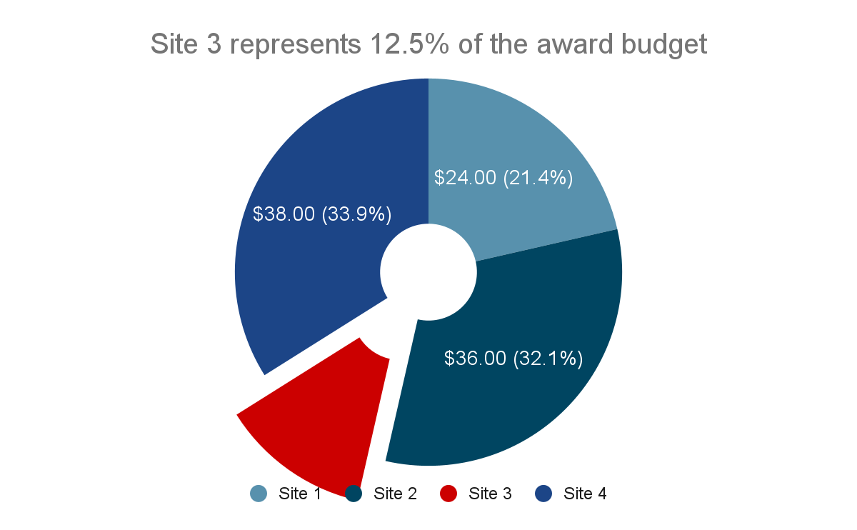
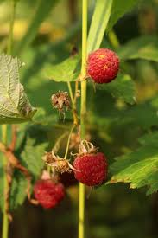
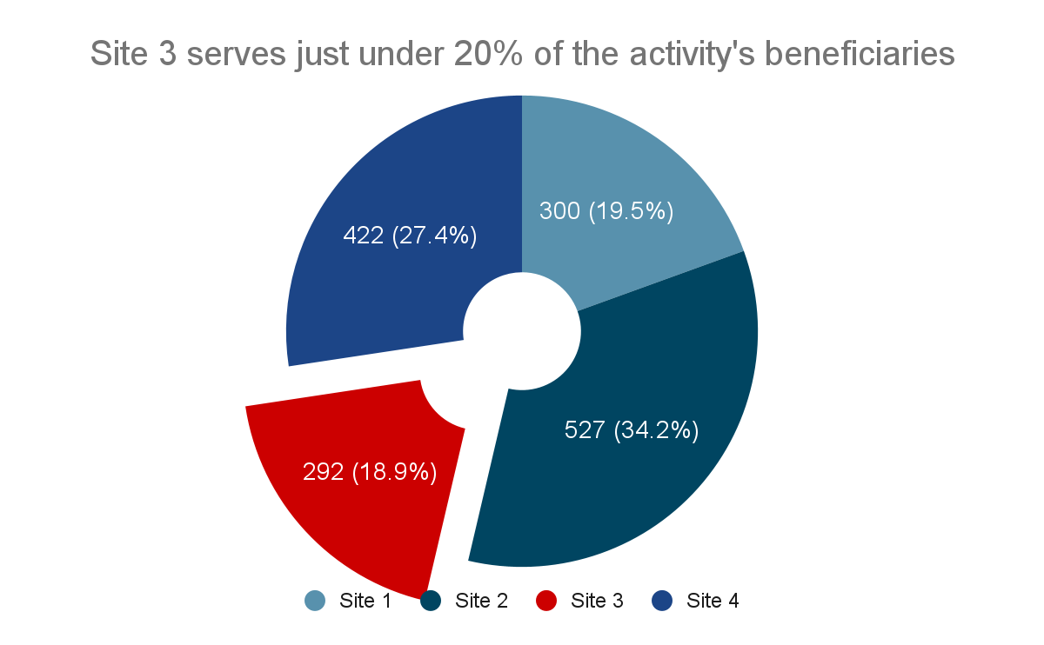
Site Summary: RED NEO Raspberry Farm
Rural Economic Development and New Economic Opportunities (RED-NEO), 2019-2024
CARD Foundation, with AM partners Consulting Armenian Women for Health and Healthy Environment
Objective: strengthen horticulture/viticulture value chains, agritourism, agricultural mechanization services
Relevant targets or learning questions from AMELP
Assumptions from AMELP that relate to LQs
Risks from AMELP that relate to LQs
DO Context Indicators that might impact this activity
DO Context Indicators that might impact this activity
Data Viz 1: relevant context indicator (trends over time if possible) from DO
DO RF with highlighted subIRs that this activity contributes to
The RED NEO Activity is making progress toward its objectives, but different sites may be affected more or less by COVID, the NK conflict, and economic sanctions against Russia, which are anticipated to destabilize agricultural markets.
RED NEO has provided grants to 59 businesses
(Year 5 target = 100 businesses), allowing recipients to procure modern equipment, improve facilities, and branch out to new lines of business.
Data Viz/headline/pull quote 3:
How has the activity shown resilience to the crises?
It is presently unclear how economic sanctions against Russia, due to the war in Ukraine, are impacting grant recipients’ ability to reach their intended markets.
Key Achievements of this site:
Key Challenges this site is grappling with:
So...Is the Development Hypothesis still relevant?
[Add DH here]
** Save some space in this box to document the conclusions from the group conversation **
Dealer’s Choice: gender/youth/marginalized population data if we have it OR anything else particularly interesting/surprising
What can other sites/activities learn from this one? What do they want to learn from others?
** Save some space in this box to document the conclusions from the group conversation **
Notes:
Learning Questions
How were/are the activities at this site expected to contribute to USAID/Armenia’s development goals?
How have the COVID-10, the NK conflict, the war in Ukraine and international sanctions on Russia fundamentally changed the assumptions for this activity when it was designed?
How have our Implementing Partners been adapting in these crises, what challenges they face and how can USAID strengthen household, community, and country resilience?
How have these crises impacted women, youth and traditionally marginalized groups differently under the activities at this site?

