Slide 1
Virtual Facilitation
Resources & Inspiration for USAID Facilitators and Stakeholders

Slide 2

Table of Contents
Resource Categories
Engagement & Participation
Managing Tricky Situations/People
Facilitating Hybrid Meetings (In-Person + Virtual Participants)
Agenda Design & Clear Purpose (Resources And Ideas)
Blank Templates

Slide 3
“Resource Deck” Proposal at a Glance
Each sprint session will be focused on a facilitation topic
Wily participants will identify one or more resources to share during the session, adding a slide to this deck
Brief (3-5 min) “lightning talks” are followed by a chance to socialize ideas/questions
A slide template is provided but creativity is encouraged
This is one way to increase knowledge and confidence, share expertise, build community, and capture resources for broader use

Slide 4
A wordier version of the proposal ;)
We will use this Google deck to capture ideas, resources, and materials related to big categories of virtual facilitation like agenda-building, materials, decision-making and others. Each session will be organized around a single big topic. Sprint participants will be invited to create one or more slides related to the topic before the convening: a tool or toolkit they love, a blog post or articles, or another resource they recommend. A template will be provided for consistency, though creativity in presentation is encouraged.
The major part of each convening will consist of brief (3-5 min) presentations, or facilitations, of activities or resources added to the Google slide deck, with 3-5 mins for discussion. Over the course of the sprint, we will assemble a broad array of socialized resources.

Slide 5
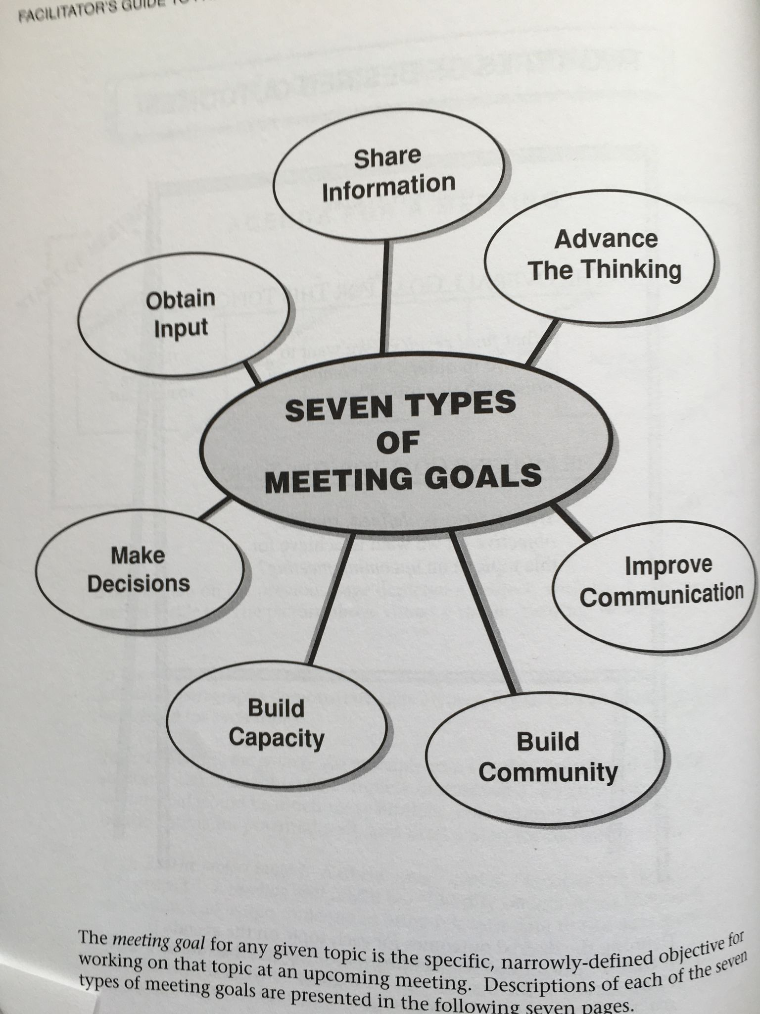
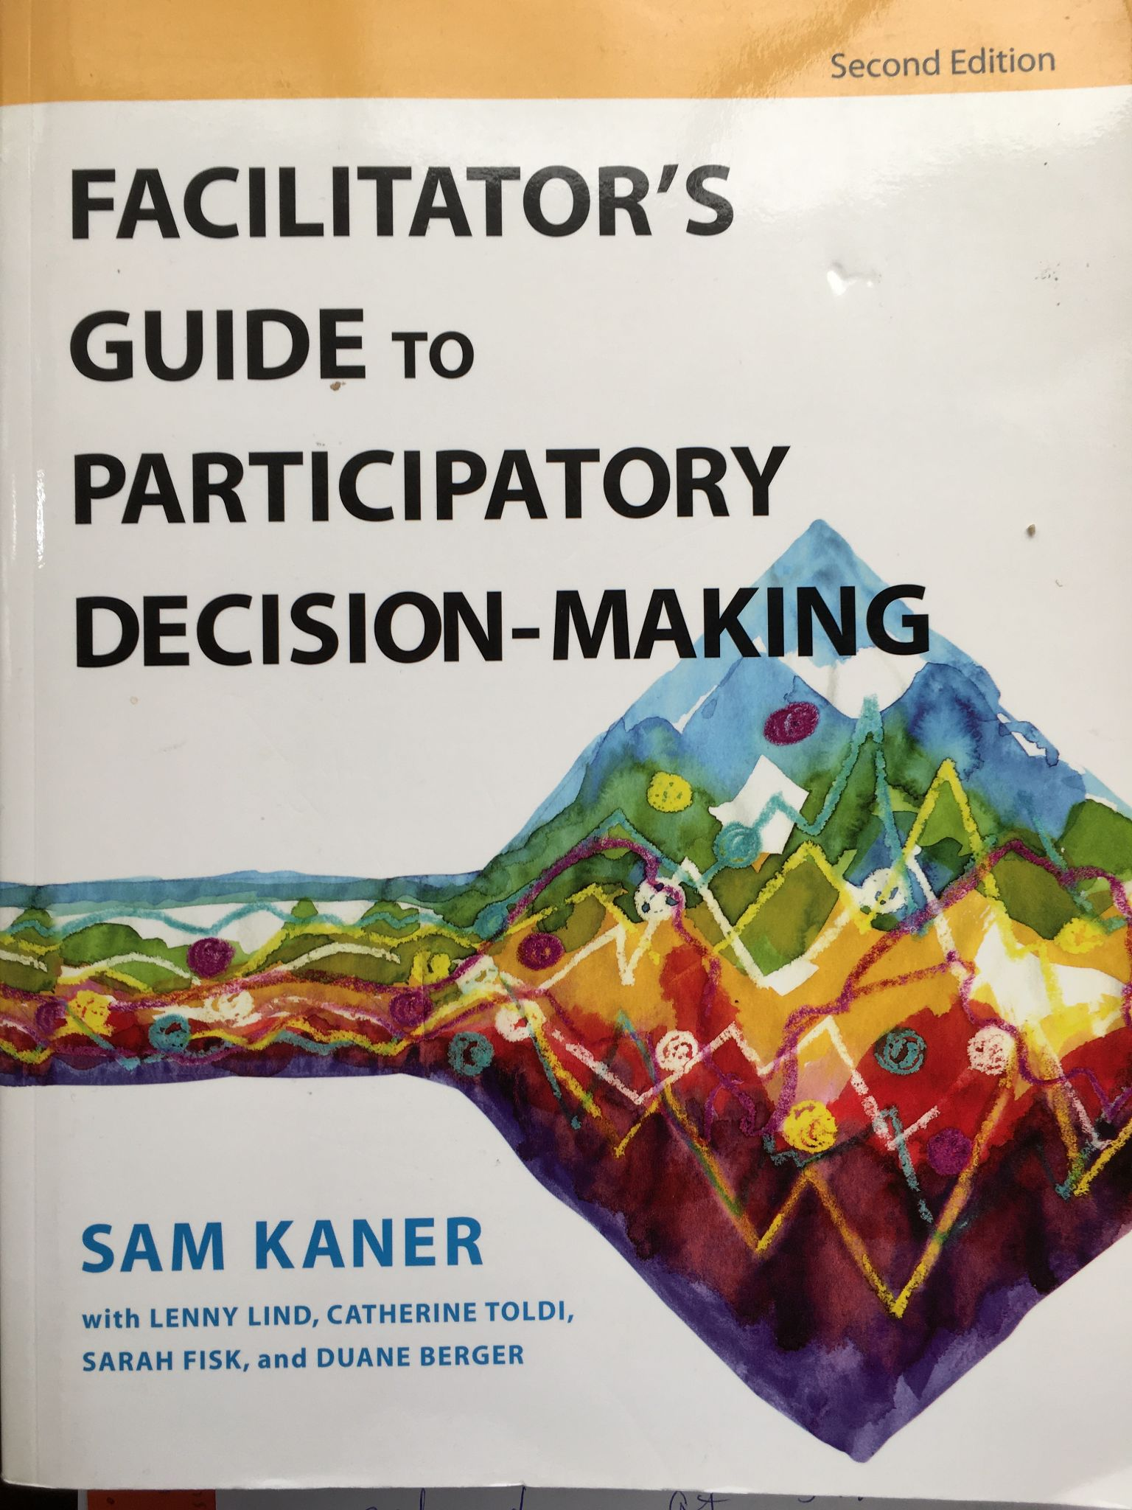
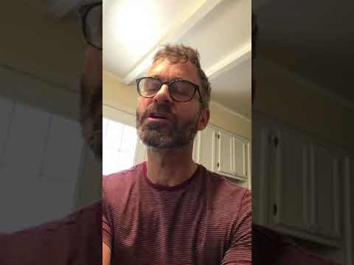
Book: Facilitator’s Guide to Participatory Decision-Making
EXAMPLE
Description
An eminently practical book by Sam Kaner and co-authors. So many wonderful resources to understand how to approach meeting design and to structure your meeting to align to your goals (see right). Highly recommended.
Links
Book on Goodreads
Category: Agenda Building
Resource Type: Book
Contributor: Michael Weinraub
Notes:
I’ve used this & happy to share my experience
<add your name here>

Slide 6
Title
(Can run two lines)
IMAGE 1 HERE
IMAGE 2 HERE
Description
This is a space to write a short description of the resource.
Links
This is a space to add a link to the book or other resources.
SCREENSHARE HERE
Category: [Type]
Resource Type: [Type]
Contributor: [Name]
Date added: [Date]

Slide 7
ENGAGEMENT & PARTICIPATION
(Resources and Ideas)
Description: Creating the conditions for meaningful participation and engagement in meetings is vital. What have you seen or done that has helped you to engage participants? What resources do you know about that could be helpful to others?
Select a slide in this section below to share your ideas/resources. You may (and are encouraged to/) create more than one slide.
Note: It is not necessary to include a video clip.

Slide 8

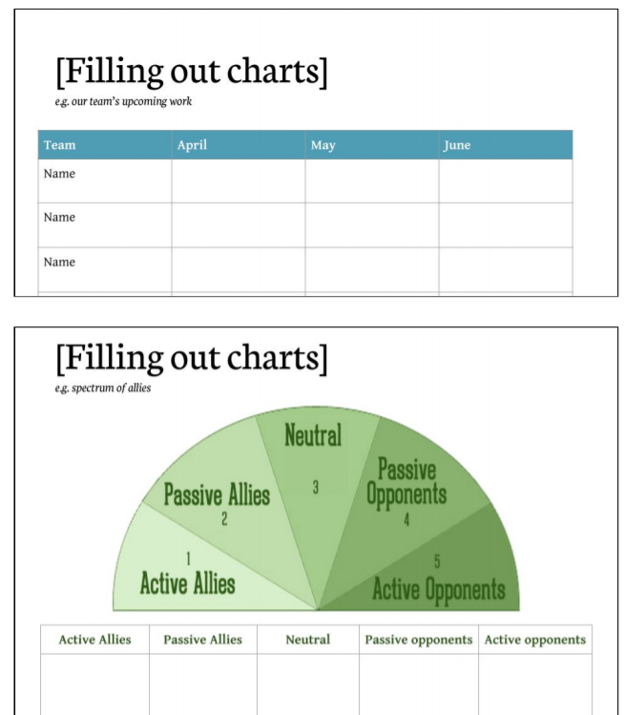
Leading Groups Online:
Description
Quick read with all the basics in one place, distilled to 10 Principles. Include lots of examples for use in any platform.
Links
Leading Groups Online - free download
Available in 5 languages
Category: General Engagement Principles
Resource Type: Guide/PDF with templates
Contributor: Jen Page
Notes:
Comments:
(Michael Weinraub): Jen, I love how it says on the website, that in response to the pandemic “Jeanne Rewa and Daniel Hunter swiftly wrote this booklet for this moment.” A lot of content and guidance for virtual facilitation has come out over the last year.

Slide 9
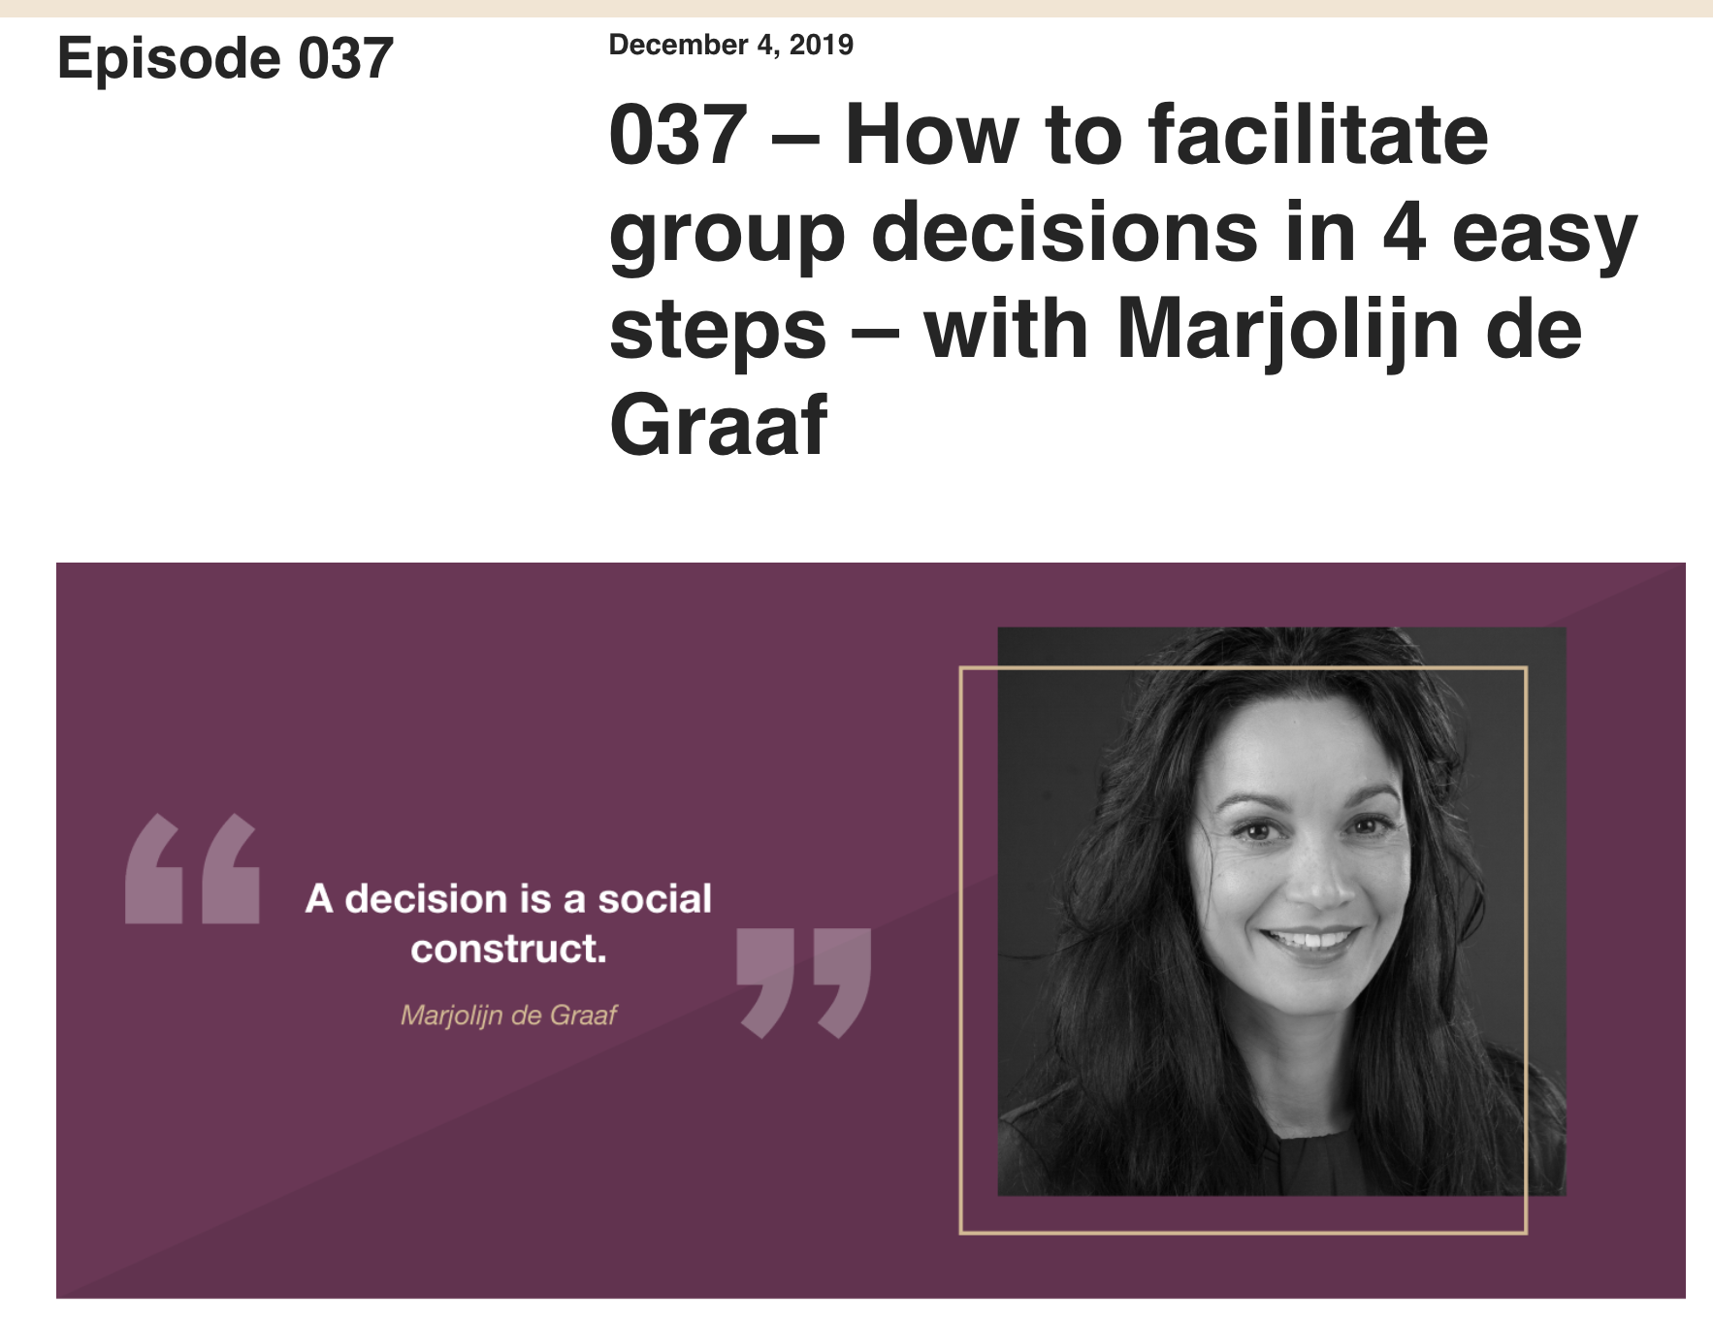
Podcast: Decision Making
Description
I’ve come to be a big fan of Myriam Hadnes’ work through https://workshops.work/. This conversation w/ “decision designer” Marjolijn de Graaf provides a great justification for being transparent about what you’re asking folks to do and how decisions are made. That transparency puts folks at ease and invites them to participate fully.
Links
https://workshops.work/podcast/037/
Category: Engagement
Resource Type: Podcast and website
Contributor: Michael Weinraub
Notes:
Comments:

Slide 10
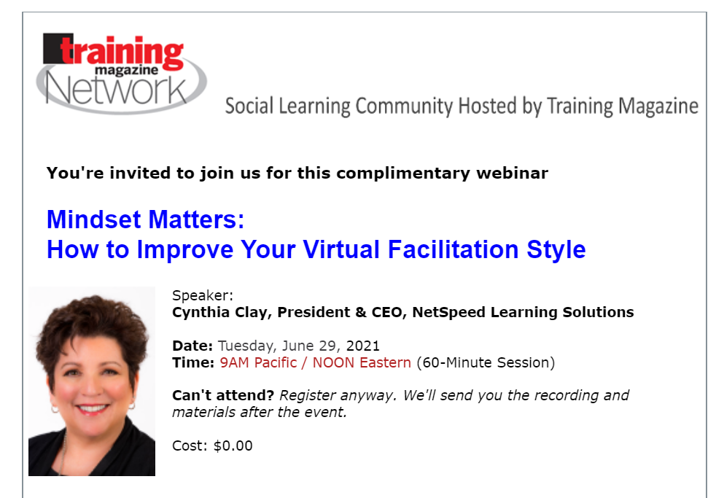
Mindset Matters: ﻿How to Improve Your Virtual Facilitation Style
Description
Should the virtual classroom be led by the News Anchor, the Podcaster, the Airplane Pilot, the Technology Guru, the Energizer Bunny, or the Guide on the Side?
Links
Tuesday, June 29 at noon ET
Registration free (but will get spammed)
Learning Objectives
Describe six virtual facilitation styles and their related strengths
Avoid the weaknesses of each of the six styles
Enhance your online facilitation style to create greater engagement and connection
Bring the Virtual Facilitator Trainer Certification (VFTC) program to your organization
Category: Facilitation Style
Resource Type: Training
Contributor: Jen Page
Notes:
Comments:

Slide 11


7 Golden Rules for Hosting Webinars that Engage and Convert
Description
How do we create a webinar that’s engaging? How do we create a learning space that is interesting and gives the learner a reason to listen and participate?
Links
copyblogger.com/webinars-engage-convert/
Category: Engagement
Resource Type: Blog
Contributor: Mat Milgram
Notes:
Comments:
Michael Weinraub: I like “6. Record evergreen content” the reminder that a lot of content can be used and lightly revised and adapted.

Slide 12

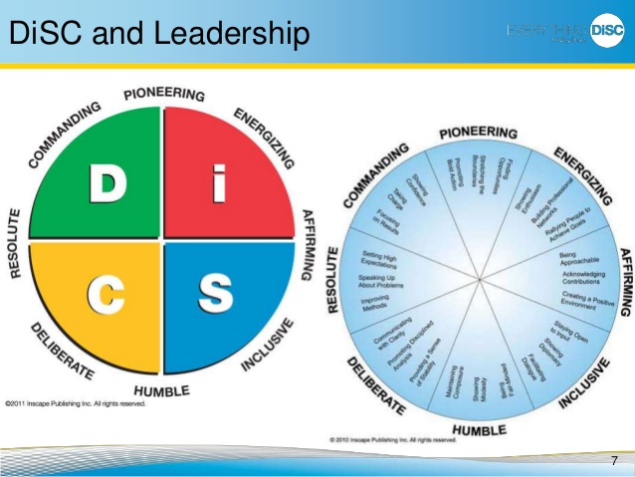
The 8 Dimensions of Leadership
(DiSC Strategies for Becoming a Better Leader)
Description
Helps you identify yours and coworkers styles of leadership
Helps showcase how everyone brings something different to the table and to complement each other.
Links
Found on Amazon and Library websites
Category: Leadership
Resource Type: Book
Contributor: Meghan Persaud (formerly Meghan Shaw/got married & in name change process)
Notes:
Comments:
-- Megan Hill: I love DiSC! I’ve found it very useful (even more so than Myers-Briggs).

Slide 13
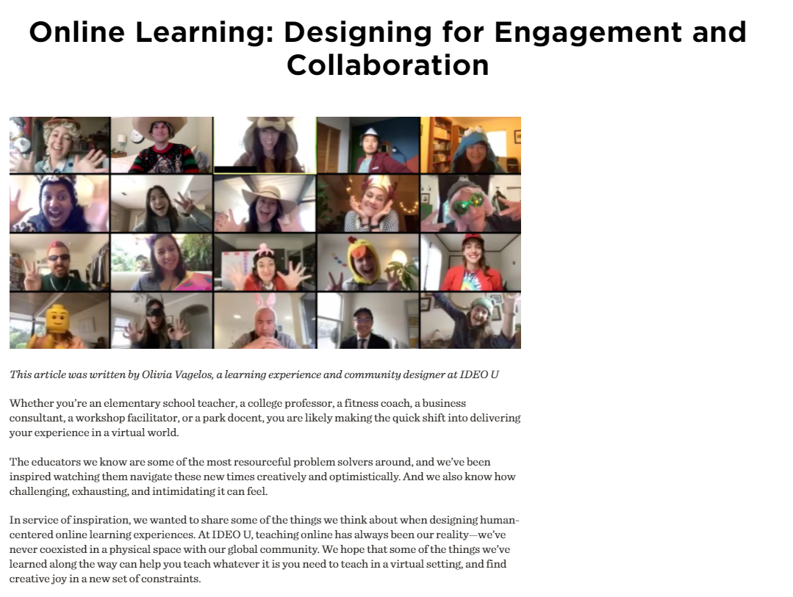
IDEO U - Online Learning: Designing for Engagement and Collaboration
Description
Tips and reflection/ design questions to help adapt material and identify appropriate engagement techniques for the virtual environment - written by Olivia Vagelos, a learning experience and community designer at IDEO U
Links
https://www.ideou.com/blogs/inspiration/online-learning-designing-for-engagement-and-collaboration
Category: Engagement
Resource Type: Blog
Contributor: Jessica Lucas
Notes:
Comments: I like this idea of really purposefully integrating synchronous and asynchronous, but wonder how it works with different audiences-- I use this blend all the time with internal USAID engagements, but what about with external audiences, how well do people find this works?
Also for both internal and external, what’s the right balance of asynchronous and synchronous. I worry about giving too much “HW”.

Slide 14

Liberating Structures Menu
Description
A menu of activities and approaches to encourage inclusive interactions, listening, and planning. Each is presented as a “mini” facilitation guide. Range from simple to complex.
Links
Liberating Structures menu of approaches
Category: Engagement
Resource Type: Website
Contributor: Karen Fowle
Notes:
Comments:
DC Area Practice Group on Facebook and sign up for the email list from there: https://www.facebook.com/liberating.structures.dc/
Michael Weinraub: Thanks so much for sharing, Karen. You’re right, I am into Liberating Structures! And yes, Jessica, one way the app totally rules (over the website) is that it allows you to group and search in a way that the website does not. https://apps.apple.com/us/app/liberating-structures/id1206361128
Michael Weinraub: I love Liberating Structures and tweeted about my journey through all 33 structures at https://twitter.com/mweinraub87/status/1278438688993804289
Megan Hill: There is even an app that you can add to your phone. It’s useful to me when I need quick ideas for facilitation methods.
Appreciative interviews and the WHys
Also Jessica has used lots! Almost all.

Slide 15
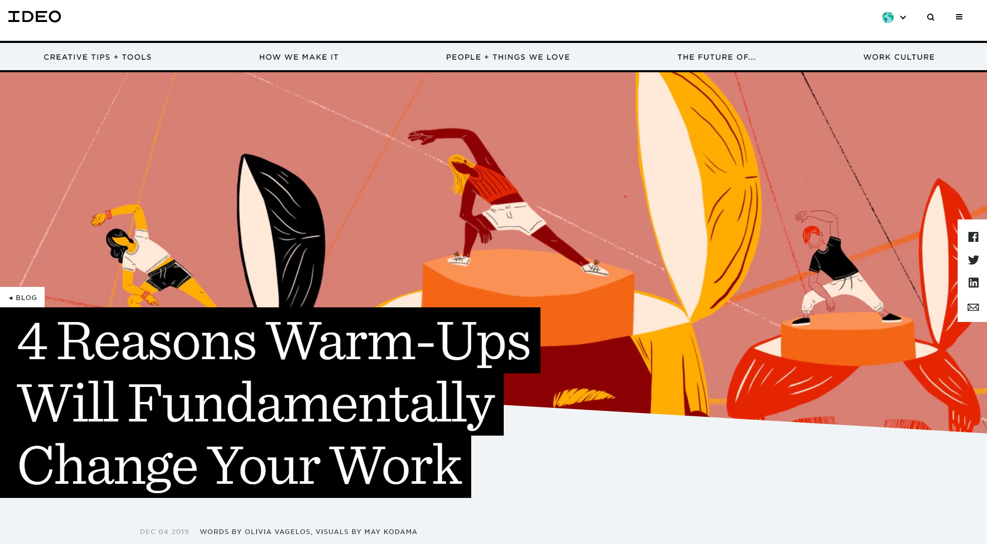


IDEO: 4 Reasons Warm-Ups Will Fundamentally Change Your Work
Description
Provides 4 reasons that warm-ups are important for collaborative working sessions.
Links
https://www.ideo.com/blog/4-reasons-warm-ups-will-fundamentally-change-your-work
Category: Engagement
Resource Type: Blog
Contributor: Jessica Lucas
Notes:
Comments:
Can also find specific techniques on the IDEO site
Michael Weinraub: I get sooo many ideas and much guidance from IDEO. I recently bought The Field Guide to HCD at https://www.designkit.org/resources/1

Slide 16
Sharing Our Experiences - Tour d’OTI Event
Description
Following a staff re-org and process to define team roles, this event served to (re-)introduce staff to all teams, gain clarity on their functions, provide updates, and create awareness of team communication preferences.
Goal = make the “Core Work Document” real
and not be super boring.
Links: Fac Plan, Notes Template, Presentation Guidelines, Event Comms (links removed)
Event Features
4 rounds of breakout rooms, 14 teams each present once
  Each participant only hears 4 presentations
Participatory Knowledge capture: Team notes document
Post-event learning: team knowledge share and use as an on-boarding document
Lessons learned
Setting up breakout rooms in advance
More coaching for team presentations and structure
2 producers are necessary when using Google Meet
Team notetaking didn’t really happen
Category: Virtual Engagement
Resource Type: Example
Contributor: Monica Krause

Slide 17
Excerpt: Seven Types of Meeting Goals
Description
The chart on the right from The Facilitator’s Guide to Participatory Decision-Making (p.162) provides an incredibly helpful list of things that we might want to accomplish during a meeting, or one small part of a meeting. Forcing yourself to identify what you want to accomplish is outrageously helpful for design -- and opens up a world of structures that align to that purpose.
Category: Agenda Building
Resource Type: Book
Contributor: Michael Weinraub

Slide 18
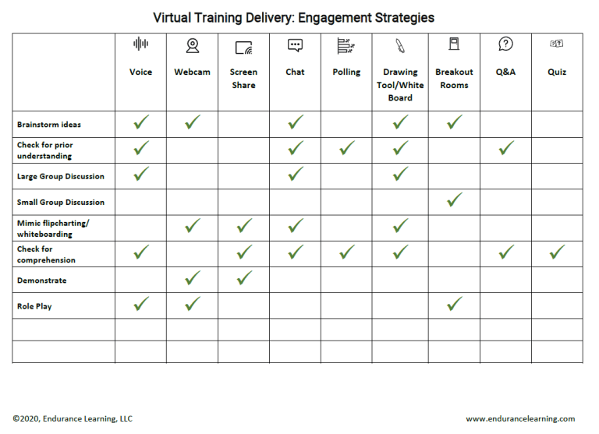
Virtual Training Delivery: Engagement Strategies
Description
Job aid offering quick ideas on matching virtual tools to type of engagement. Great for a quick reference!
Links
This is a space to add a link to the book or other resources.
Category: Engagement & Participation
Resource Type: Job Aid
Contributor: Jen Page

Slide 19
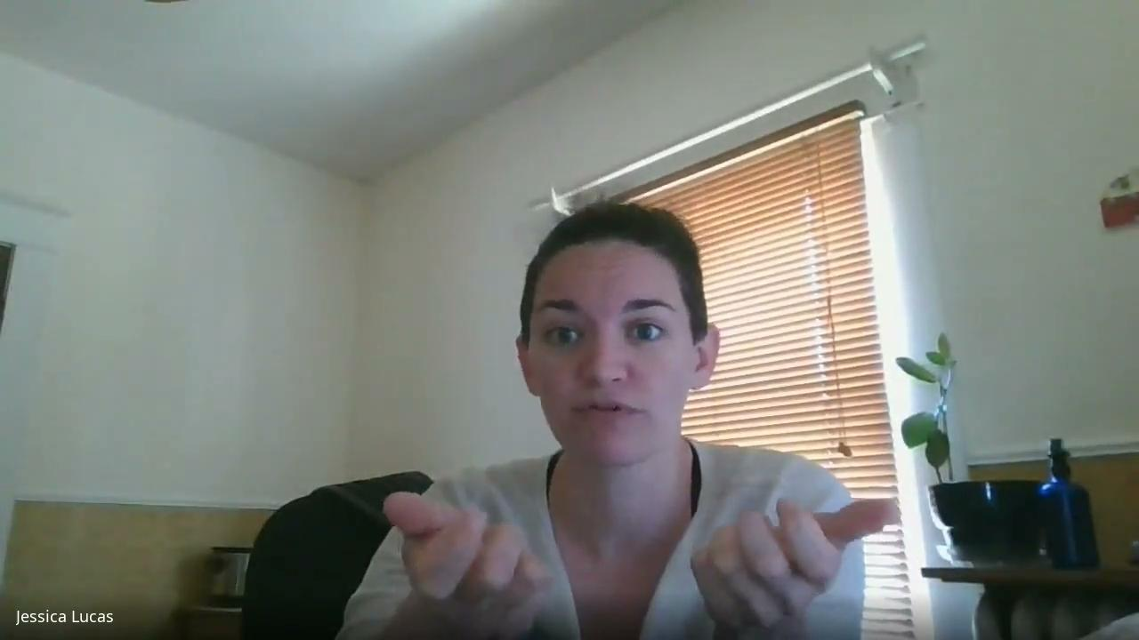
Share Back on Select Engagement & Participation Resources
Notes:
Comments:
Michael Weinraub - I really love having video clips of sharings and presentations. It puts us “back in the room” to connect with why our colleagues selected and use certain resources.

Slide 20
MANAGING TRICKY SITUATIONS/PEOPLE
(Resources and Ideas)
Description: Things don’t always go smoothly! Sometimes you can anticipate challenges and try to mitigate them (always a good idea!!). Sometimes you get surprised. Being aware of potential trouble spots and getting familiar with how to deal them can be a big help!
Select a slide in this section below to share your ideas/resources. You may (and are encouraged to/) create more than one slide.
Note: It is not necessary to include a video clip.

Slide 21
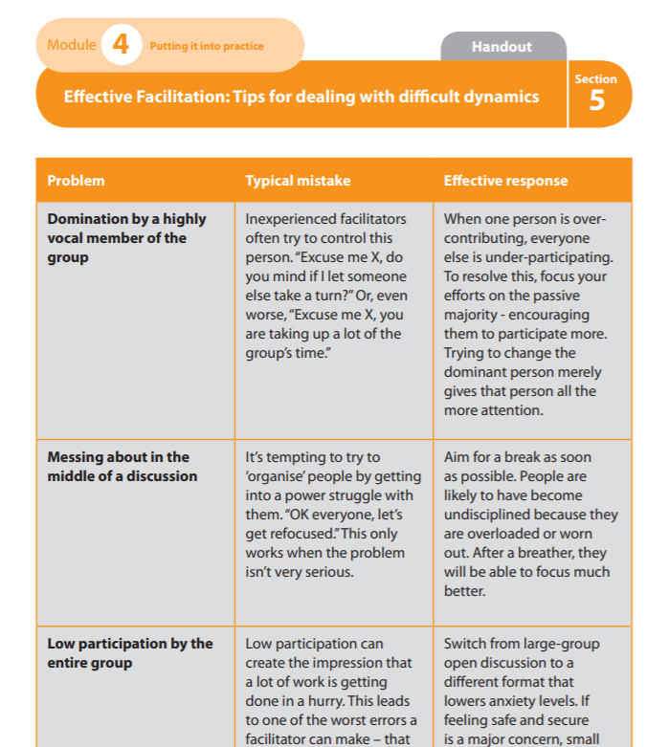
Effective Facilitation: Tips for dealing with difficult dynamics
Description
A handout of common problems, typical mistakes and effective solutions from the UK’s National Health Service Facilitator’s Toolkit
Links
See pages 69-74 in the Facilitator’s Toolkit
Category: Managing Tricky Situations/People
Resource Type: Handout
Contributor: Tanya Torres

Slide 22
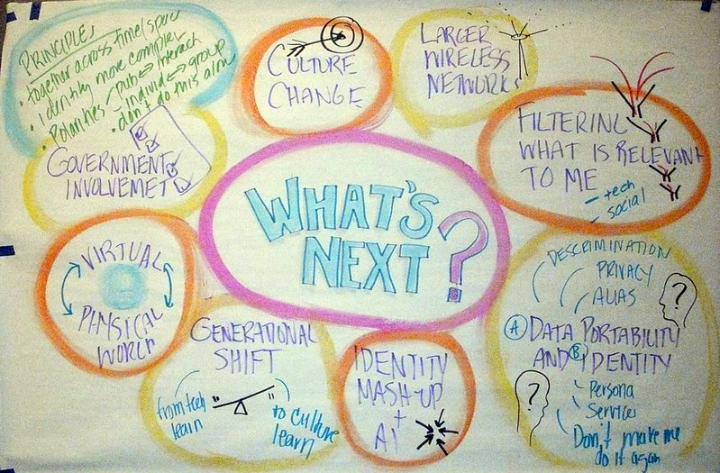
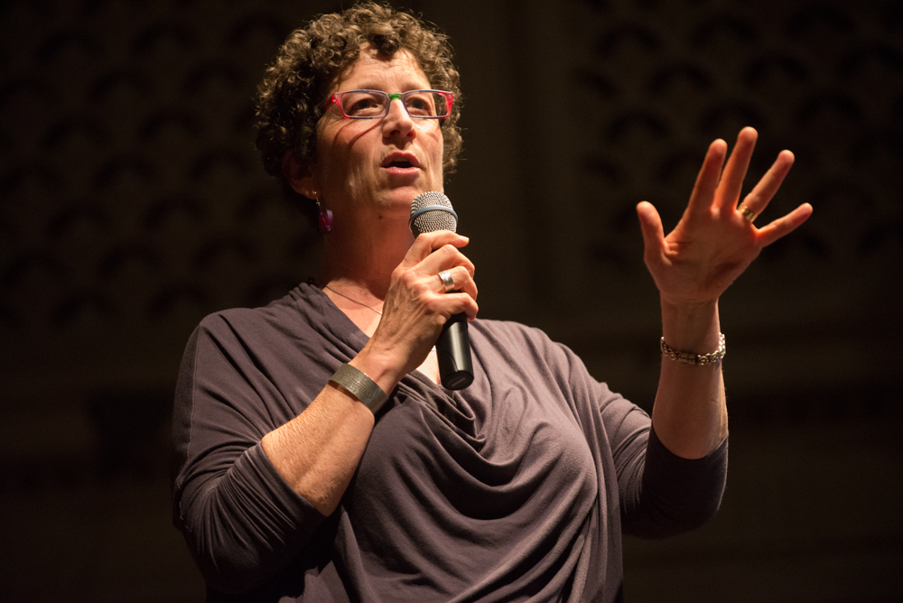
Management vs. Control and Oppression
Description
Nancy White (Full Circle Associates) warns against “facipulation” - controlling and oppressing others through well-meaning facilitation.
Links
https://fullcirc.com/2021/03/08/what-does-consent-look-like-to-you-as-a-facilitator/
Category: Managing Tricky Situations/People
Resource Type: Blog
Contributor: Tanya Torres

Slide 23
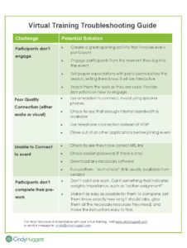
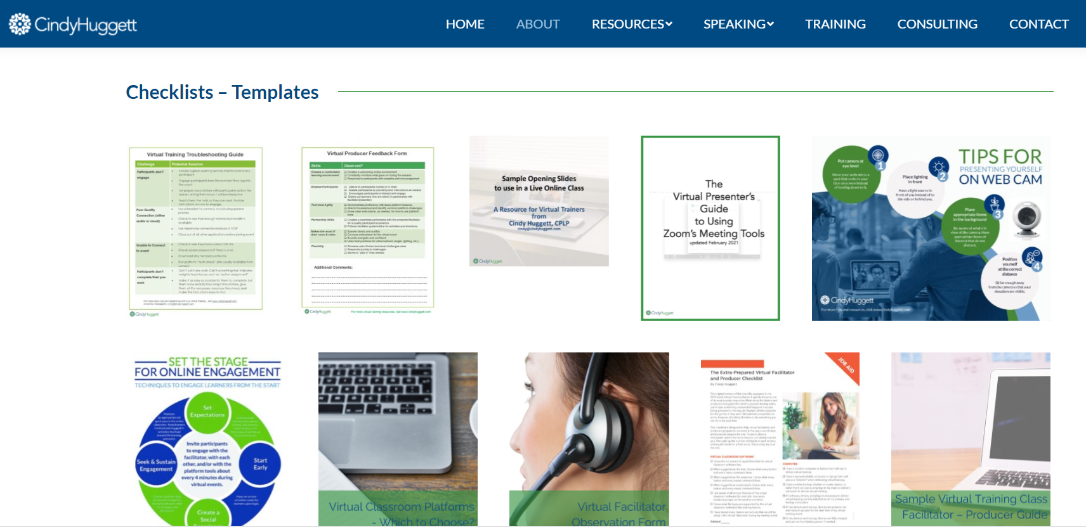
Virtual Training Troubleshooting Guide (and other checklists) by Cindy Huggett
Description
A very quick list of 4 common problems and potential solutions. Handy quick reference mid-event when things go wrong. Ultimately, planning ahead is your best defense! Check out her other resources.
Links
https://www.cindyhuggett.com/resources/#!/checklists
SCREENSHARE HERE
Category: Troubleshooting
Resource Type: Checklist/Reference
Contributor: Jen Page

Slide 24
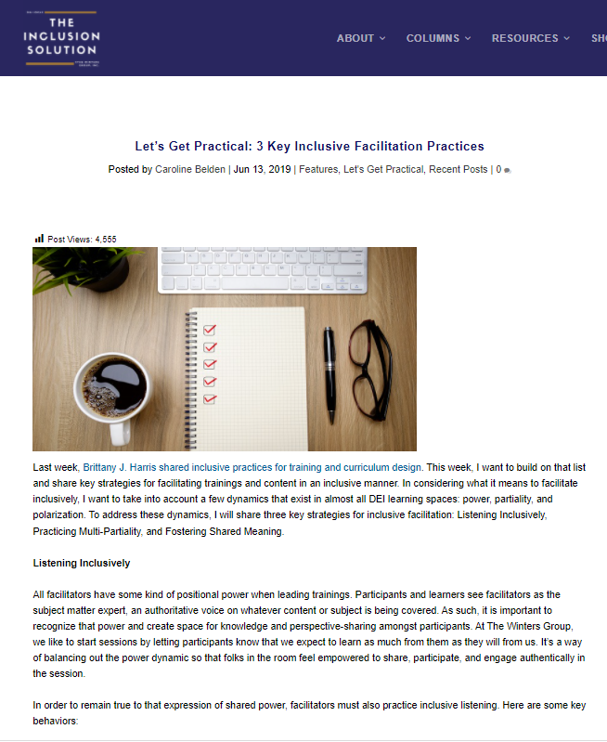
Techniques for Power Dynamics & Inclusive Facilitation Practices
Description
Recommended techniques for inclusiveness and dealing with power dynamics
Links
Let’s Get Practical: 3 Key Inclusive Facilitation Practices
Facilitator: Navigating power dynamics
Category: Managing Tricky Situations/People
Resource Type: blog
Contributor: Jen Page
Date added: 4/28/2022
Notes:
See also:
Power Dynamics: The Hidden Element to Effective Meetings
Using the "superpower" icebreaker to disrupt power dynamics
This article has some good ideas for how to manage and shape the participation of those with formal power (spoiler alert: this requires good prep of your participating leaders, always a critical step before facilitated events)

Slide 25
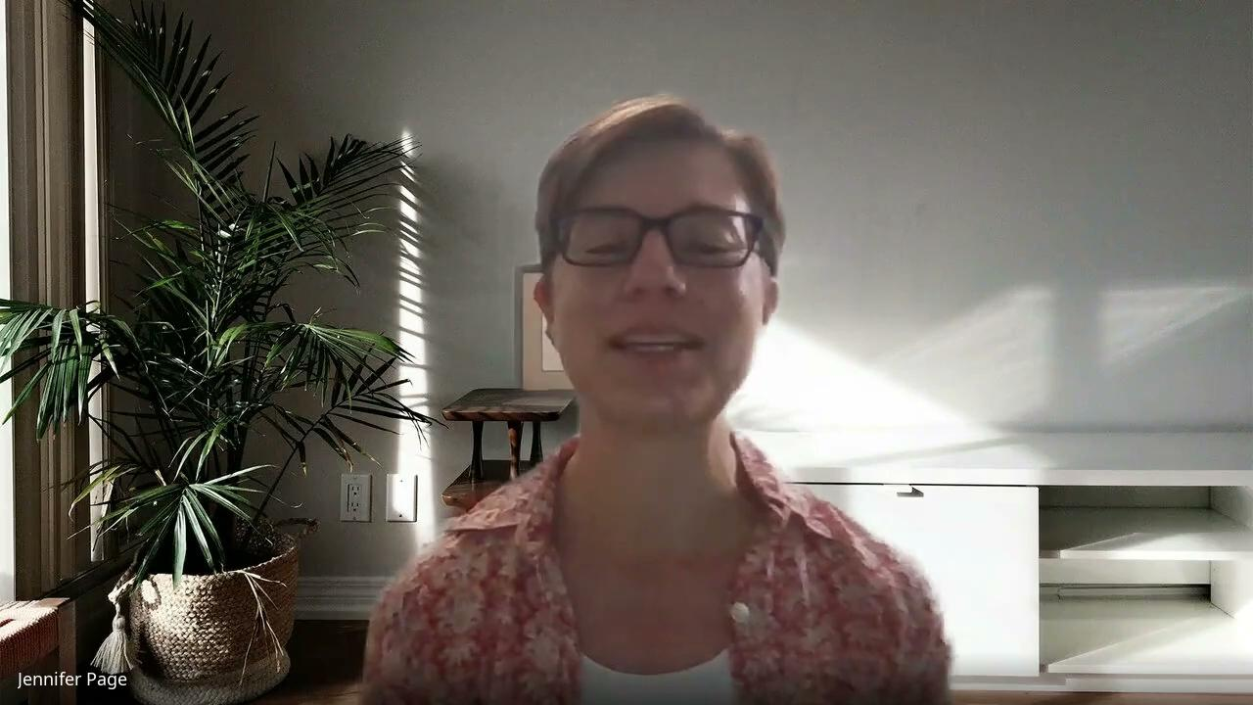
Share Back on MANAGING TRICKY SITUATIONS/PEOPLE
Notes:
Comments:

Slide 26
FACILITATING HYBRID MEETINGS in-person + virtual participants
(Resources and Ideas)
Description: Creating the conditions for meaningful participation and engagement for audiences in two different modalities (virtual & in-person) at the same time. Is it possible? What have you seen or done that has helped you to engage both sets participants? How can they interact with each other? What resources do you know about that could be helpful to others?
Select a slide in this section below to share your ideas/resources. You may (and are encouraged to/) create more than one slide.
Note: It is not necessary to include a video clip.

Slide 27
Resources may be hard to find!?
Here’s some to get us started on what we even mean by “hybrid”
Tips for facilitating hybrid classes
OAA/ARTC - video recording of presentation on hybrid training from early in the pandemic
Intro to Facilitating “Hybrid” Online Groups
Using Asynchronous Learning to EngageOnline Learners (Case Study)
Sierra Club: How to Draft: Hosting virtual/hybrid meetings (you are welcome to add/borrow)
Notes:
I am reading this article - linked from links in the Seirra Club resource: https://www.trainingforchange.org/training_tools/facilitating-hybrid-groups-online/

Slide 28
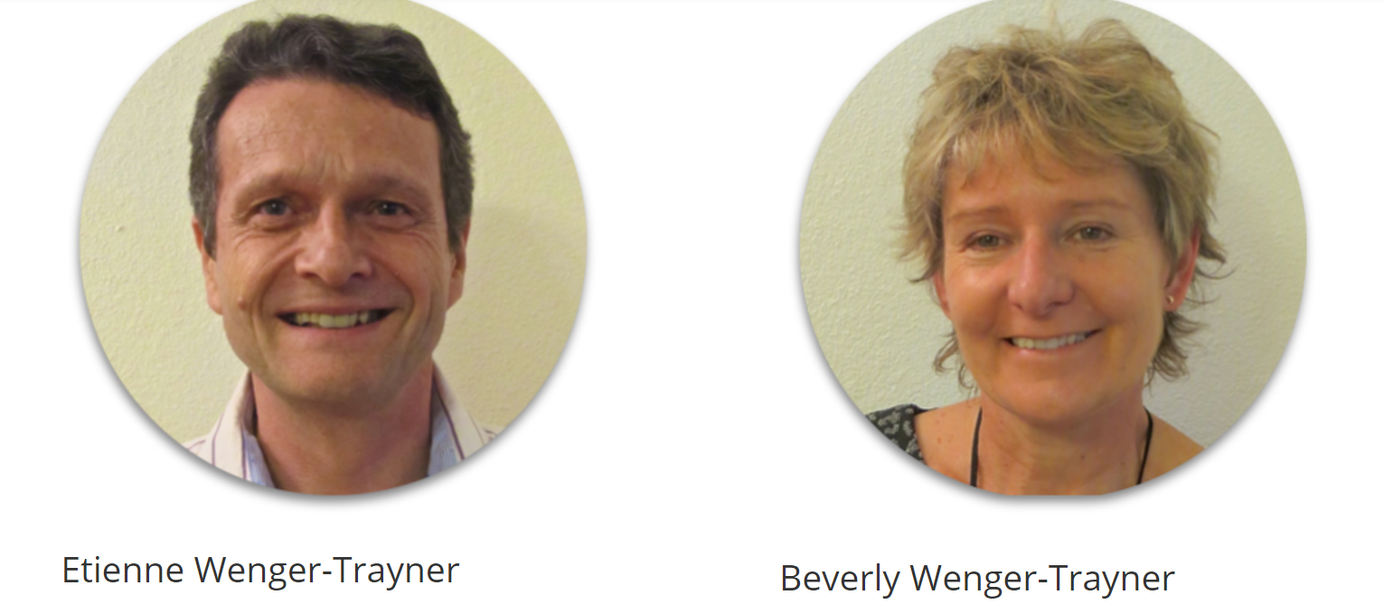
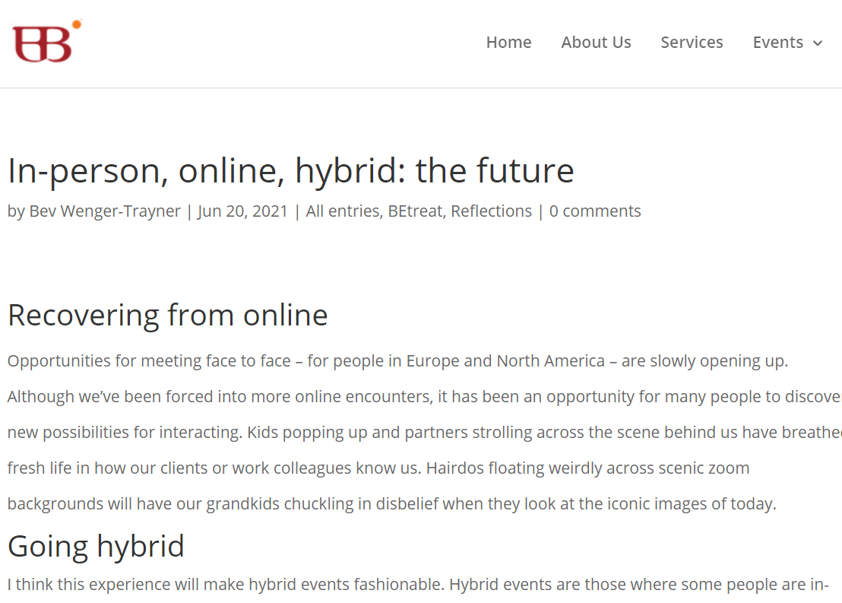
In-person, online, hybrid:
the future
IMAGE 1 HERE
IMAGE 2 HERE
Description
From KM4Dev - Bev Wenger-Trayner has just posted a great blog post giving some design and facilitation principles for hybrid events.
Links
https://wenger-trayner.com/reflections/in-person-online-hybrid-the-future/
SCREENSHARE HERE
Category: Facilitating Hybrid Meetings/Events
Resource Type: Blog Post
Contributor: Tanya Torres

Slide 29
Article from HBR: What It Takes to Run a Great Hybrid Meeting
Up your audio game.
Explore a technology boost.
Consider video from the remote participant perspective.
Make remote participants full sized.
Test the technology in advance.
Design meetings for all attendees.
Provide strong facilitation.
Give each remote participant an in-room “avatar.”
Description
Eight best practices to help make your hybrid meetings more effective.
Links
https://hbr.org/2021/06/what-it-takes-to-run-a-great-hybrid-meeting
Category: Facilitating Hybrid Meetings/Events
Resource Type: Article
Contributor: Jen Page

Slide 30

The Guide for Hosting Hybrid Gatherings - Priya Parker
I love her discussion of "the center of gravity" https://twitter.com/mweinraub87/status/1588627658212249600
-Micahel Weinraub
From the author of The Art of Gathering
Description
A short guide with tips for hybrid events. You need to sign in to receive the free guide.
Links
https://www.priyaparker.com/the-hybrid-gathering-guide
Category: Hybrid Facilitation
Resource Type: PDF Guide
Contributor:Tiffany Meyers
Date added: 11/7/2022

Slide 31
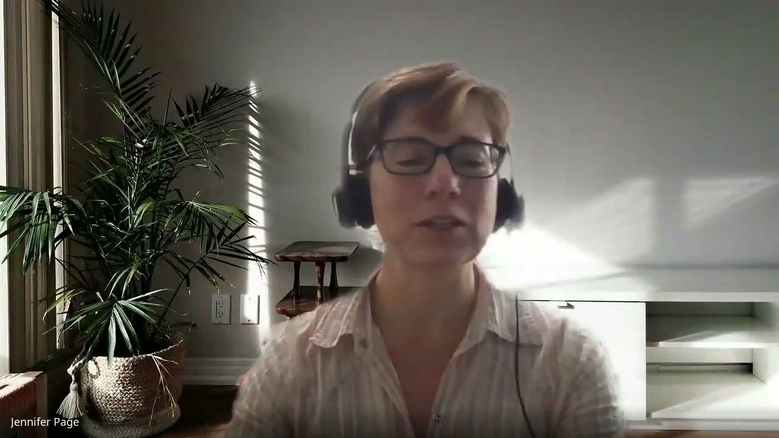
Share Back on FACILITATING HYBRID MEETINGS in-person + virtual participants
Notes:
Comments:

Slide 32
AGENDA DESIGN & CLEAR PURPOSE
(Resources and Ideas)
Description: How do you build an agenda with a clear and compelling purpose? Who should you work with to define the meeting purpose? What resources do you know about that could be helpful to others?
Select a slide in this section below to share your ideas/resources. You may (and are encouraged to/) create more than one slide.
Note: It is not necessary to include a video clip.

Slide 33
Title
(Can run two lines)
IMAGE 1 HERE
IMAGE 2 HERE
Description
This is a space to write a short description of the resource.
Links
This is a space to add a link to the book or other resources.
SCREENSHARE HERE
Category: [Type]
Resource Type: [Type]
Contributor: [Name]
Date added: [Date]

Slide 34
Title
(Can run two lines)
IMAGE 1 HERE
IMAGE 2 HERE
Description
This is a space to write a short description of the resource.
Links
This is a space to add a link to the book or other resources.
SCREENSHARE HERE
Category: [Type]
Resource Type: [Type]
Contributor: [Name]
Date added: [Date]

Slide 35
Title
(Can run two lines)
IMAGE 1 HERE
IMAGE 2 HERE
Description
This is a space to write a short description of the resource.
Links
This is a space to add a link to the book or other resources.
SCREENSHARE HERE
Category: [Type]
Resource Type: [Type]
Contributor: [Name]
Date added: [Date]

Slide 36
Title
(Can run two lines)
IMAGE 1 HERE
IMAGE 2 HERE
Description
This is a space to write a short description of the resource.
Links
This is a space to add a link to the book or other resources.
SCREENSHARE HERE
Category: [Type]
Resource Type: [Type]
Contributor: [Name]
Date added: [Date]

Slide 37
Title
(Can run two lines)
IMAGE 1 HERE
IMAGE 2 HERE
Description
This is a space to write a short description of the resource.
Links
This is a space to add a link to the book or other resources.
SCREENSHARE HERE
Category: [Type]
Resource Type: [Type]
Contributor: [Name]
Date added: [Date]

Slide 38
Title
(Can run two lines)
IMAGE 1 HERE
IMAGE 2 HERE
Description
This is a space to write a short description of the resource.
Links
This is a space to add a link to the book or other resources.
SCREENSHARE HERE
Category: [Type]
Resource Type: [Type]
Contributor: [Name]
Date added: [Date]

Slide 39
Title
(Can run two lines)
IMAGE 1 HERE
IMAGE 2 HERE
Description
This is a space to write a short description of the resource.
Links
This is a space to add a link to the book or other resources.
SCREENSHARE HERE
Category: [Type]
Resource Type: [Type]
Contributor: [Name]
Date added: [Date]

Slide 40
Title
(Can run two lines)
IMAGE 1 HERE
IMAGE 2 HERE
Description
This is a space to write a short description of the resource.
Links
This is a space to add a link to the book or other resources.
SCREENSHARE HERE
Category: [Type]
Resource Type: [Type]
Contributor: [Name]
Date added: [Date]

